Slide 1
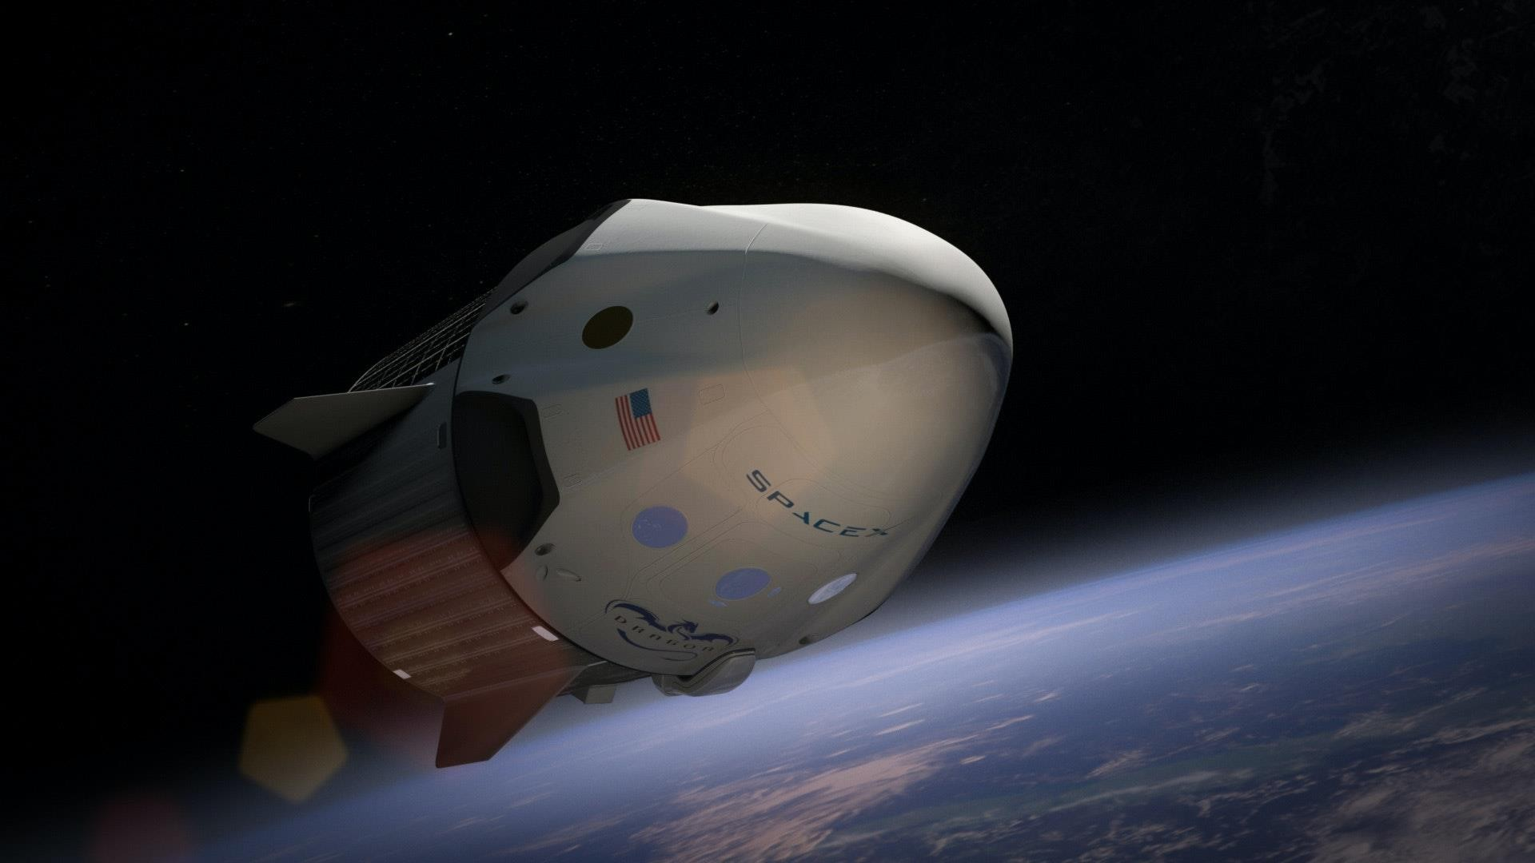
SpaceY
First Stage Reuse
Pritpal Singh 14/8/2023

Slide 2
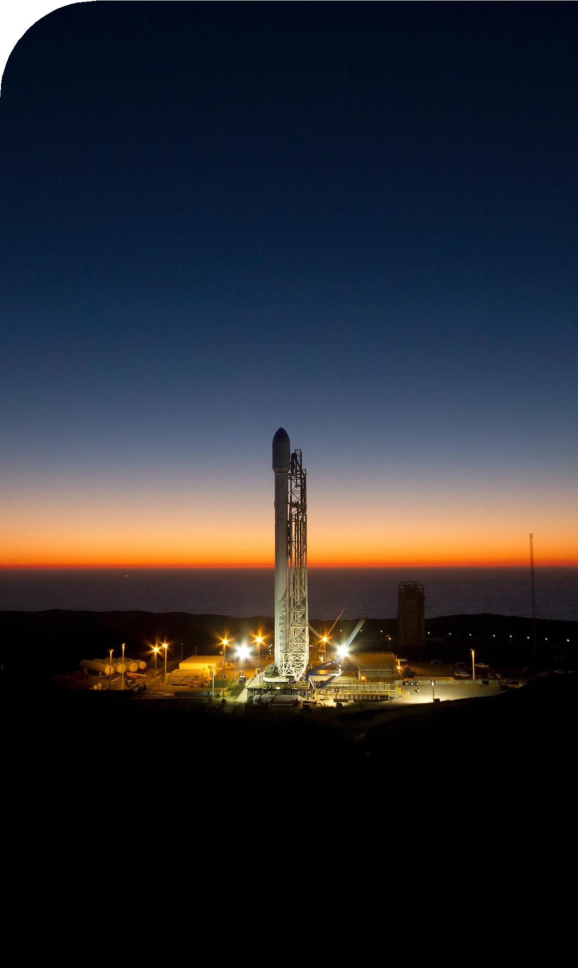
Presentation Contents
P3 | Executive Summary
P4 | Introduction
P6 | Methodology
P16 | Results
P17 | EDA with Visualization
P23 | EDA with SQL
P30 | Interactive Maps with Folium
P35 | Plotly Dash Dashboard
P39 | Predictive Analytics
P41 | Conclusion
2023
2

Slide 3
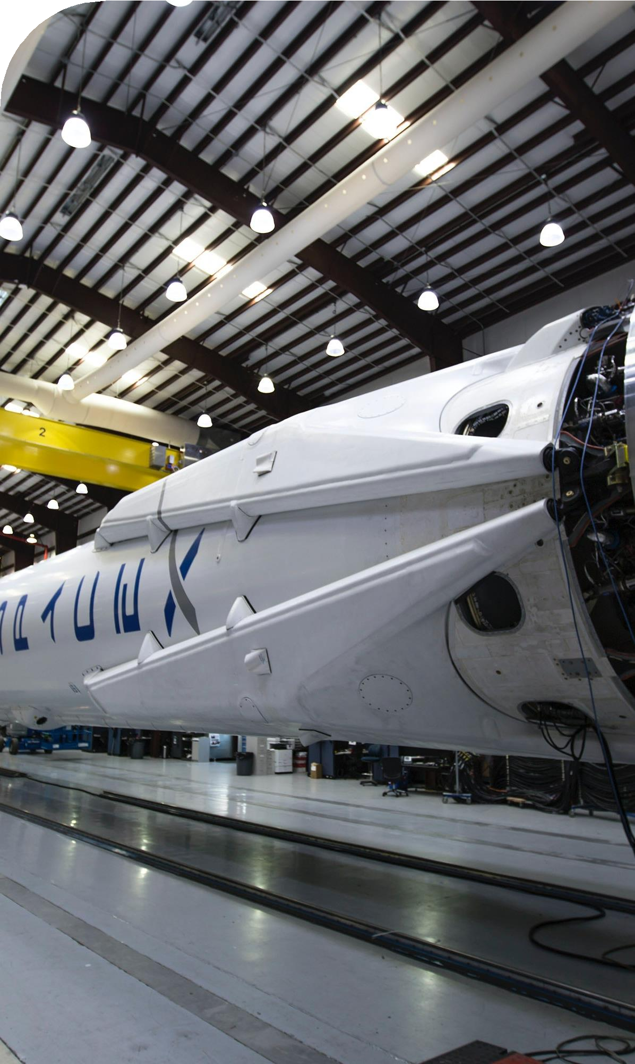
Executive Summary
Summary of Methodologies
The research attempts to identify the factors for a successful rocket landing. To make this determination, the following methodologies where used:
Collect data using SpaceX REST API and web scraping techniques
Wrangle data to create success/fail outcome variable
Explore data with data visualization techniques, considering the following factors: payload, launch site, flight number and yearly trend
Analyze the data with SQL, calculating the following statistics: total payload, payload
range for successful launches, and total # of successful and failed outcomes
Explore launch site success rates and proximity to geographical markers
Visualize the launch sites with the most success and successful payload ranges
Build Models to predict landing outcomes using logistic regression, support vector machine (SVM), decision tree and K-nearest neighbor (KNN)
Results
Exploratory Data Analysis:
Launch success has improved over time
KSC LC-39A has the highest success rate among landing sites
Orbits ES-L1, GEO, HEO, and SSO have a 100% success rate
Visualization/Analytics:
Most launch sites are near the equator, and all are close to the coast
Predictive Analytics:
All models performed similarly on the test set. The decision tree model slightly outperformed
2023
3

Slide 4
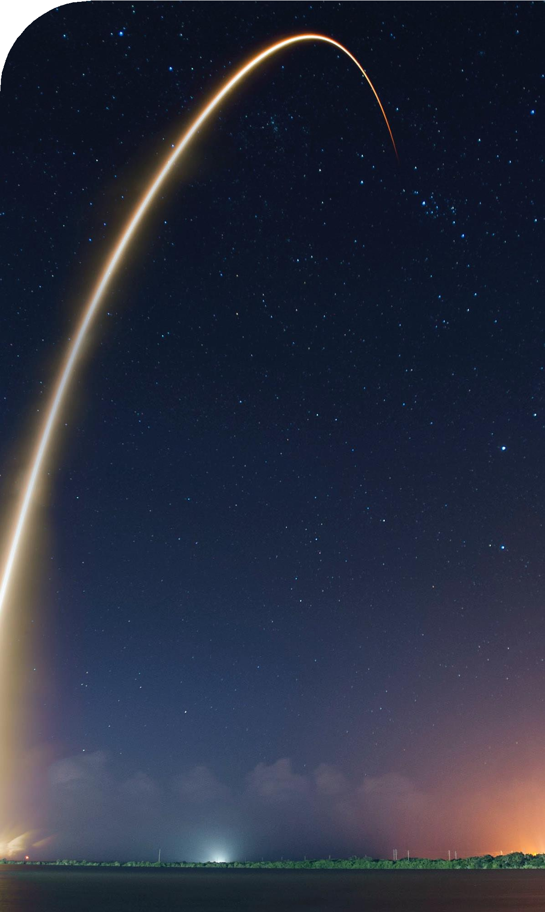
Introduction
Background
SpaceX, a leader in the space industry, strives to make space travel affordable for everyone. Its accomplishments include sending spacecraft to the international space station, launching a satellite constellation that provides internet access and sending manned missions to space. SpaceX can do this because the rocket launches are relatively inexpensive ($62 million per launch) due to its novel reuse of the first stage of its Falcon 9 rocket. Other providers, which are not able to reuse the first stage, cost upwards of $165 million each. By determining if the first stage will land, we can determine the price of the launch. To do this, we can use public data and machine learning models to predict whether SpaceX – or a competing company – can reuse the first stage.
Explore
How payload mass, launch site, number of flights, and orbits affect first-stage landing success
Rate of successful landings over time
Best predictive model for successful landing (binary classification)
2023
4

Slide 5
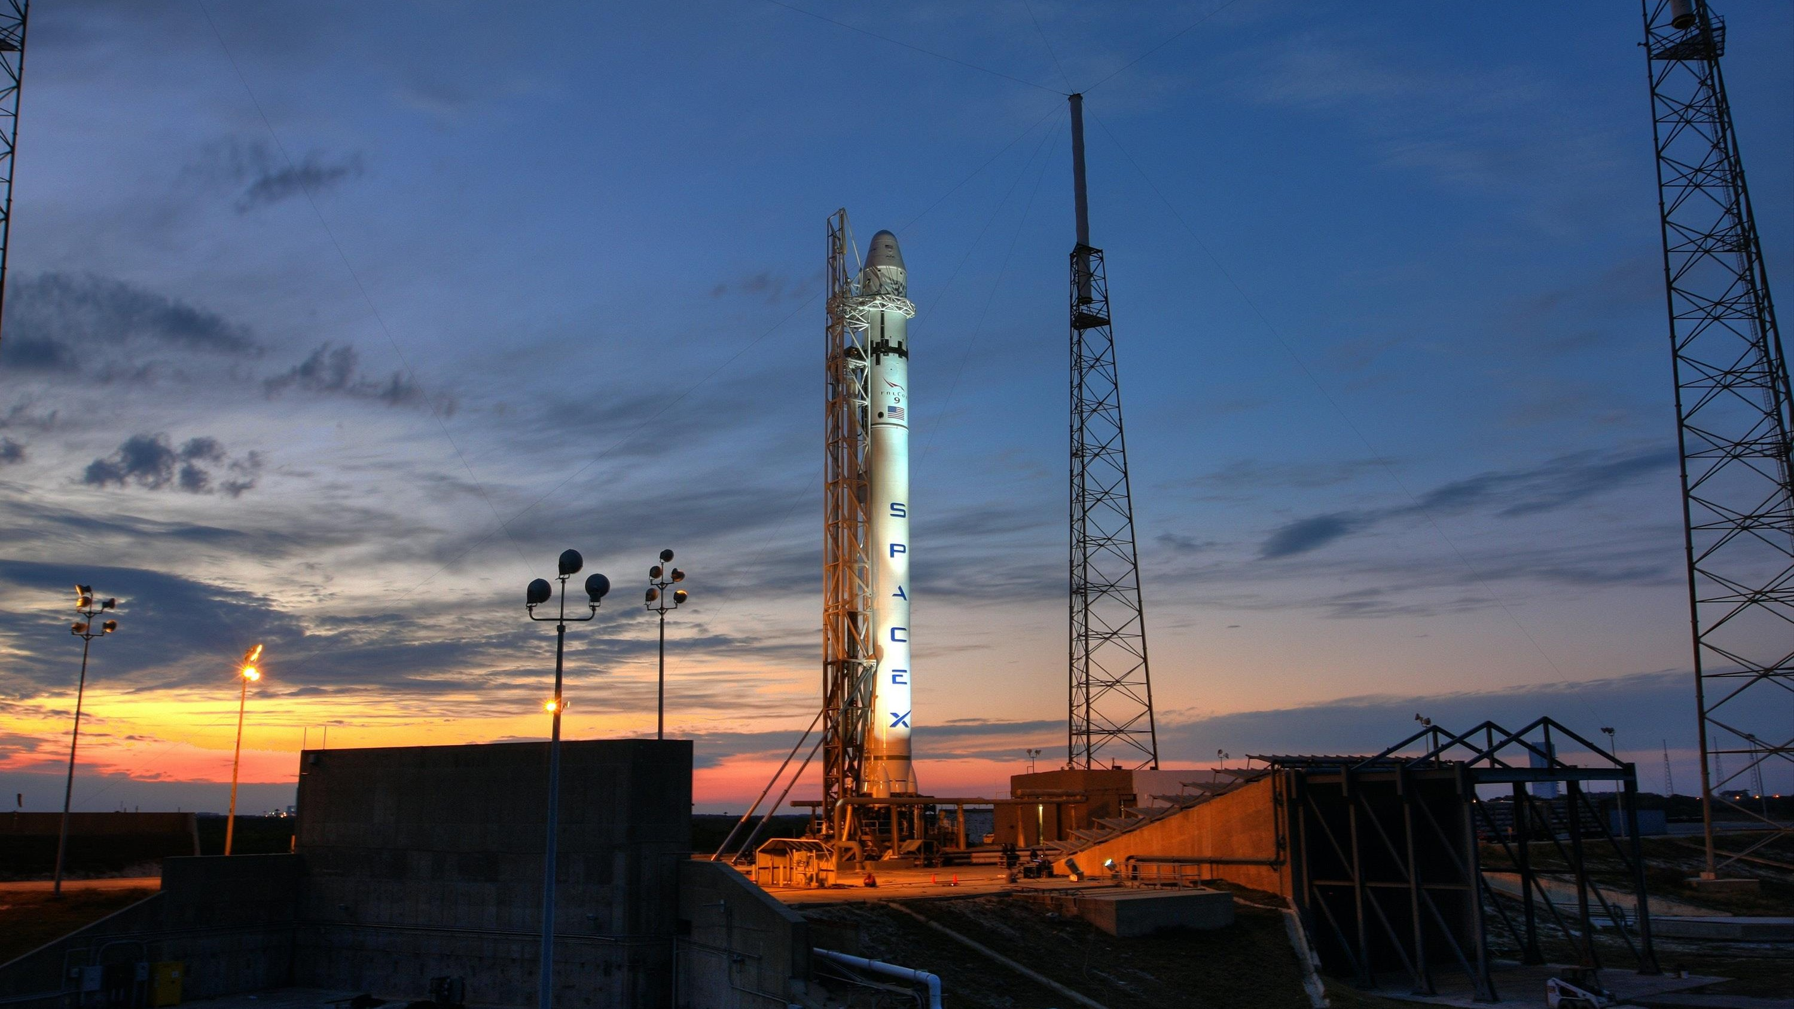
Methodology

Slide 6
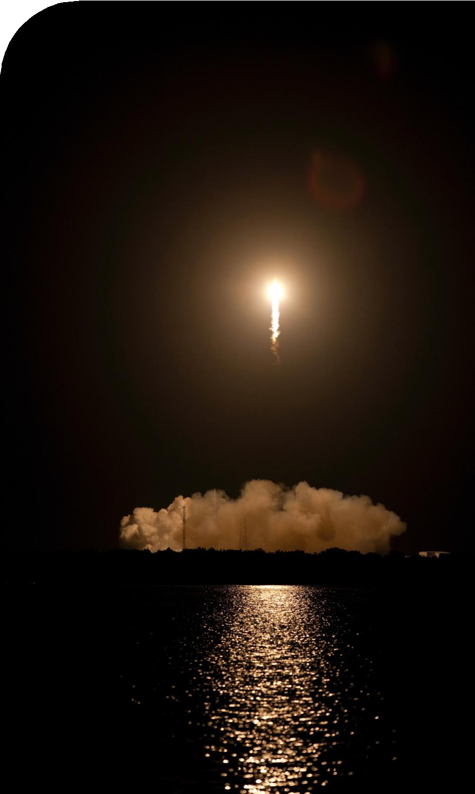
Methodology
Steps
Collect data using SpaceX REST API and web scraping techniques
Wrangle data – by filtering the data, handling missing values and applying one hot encoding – to prepare the data for analysis and modeling
Explore data via EDA with SQL and data visualization techniques
Visualize the data using Folium and Plotly Dash
Build Models to predict landing outcomes using classification models. Tune and evaluate models to find best model and parameters

Slide 7
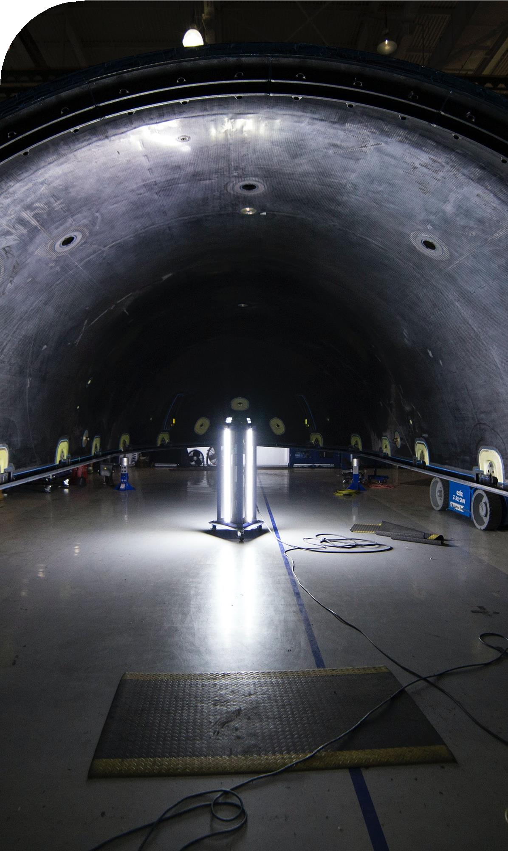
Data Collection – API
Steps
Request data from SpaceX API (rocket launch data)
Decode response using .json() and convert to a dataframe using .json_normalize()
Request information about the launches from SpaceX API using custom functions
Create dictionary from the data
Create dataframe from the dictionary
Filter dataframe to contain only Falcon 9 launches
Replace missing values of Payload Mass with calculated .mean()
Export data to csv file

Slide 8
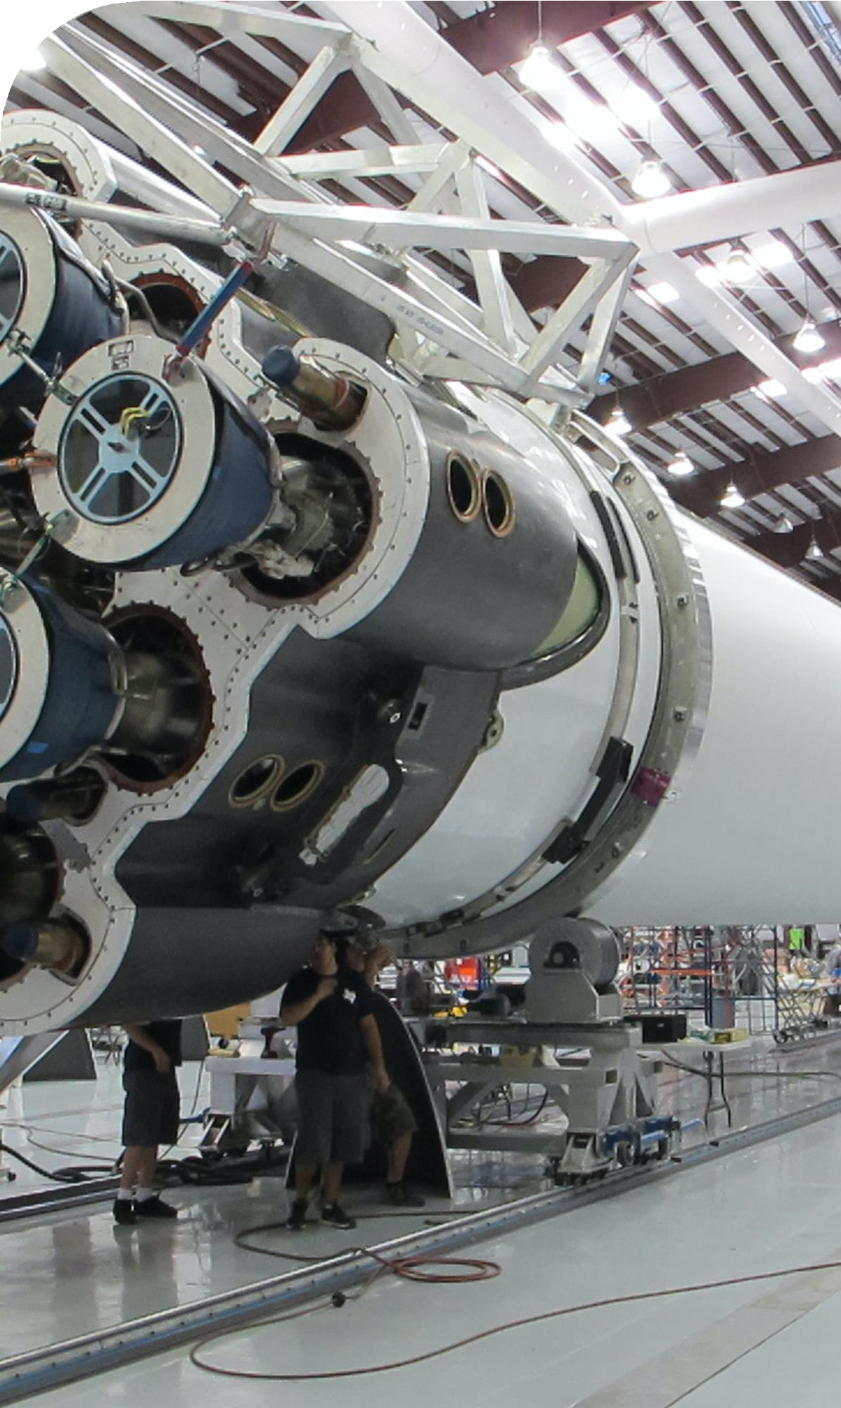
Data Collection – Web Scraping
Steps
Request data (Falcon 9 launch data) from Wikipedia
Create BeautifulSoup object from HTML response
Extract column names from HTML table header
Collect data from parsing HTML tables
Create dictionary from the data
Create dataframe from the dictionary
Export data to csv file

Slide 9
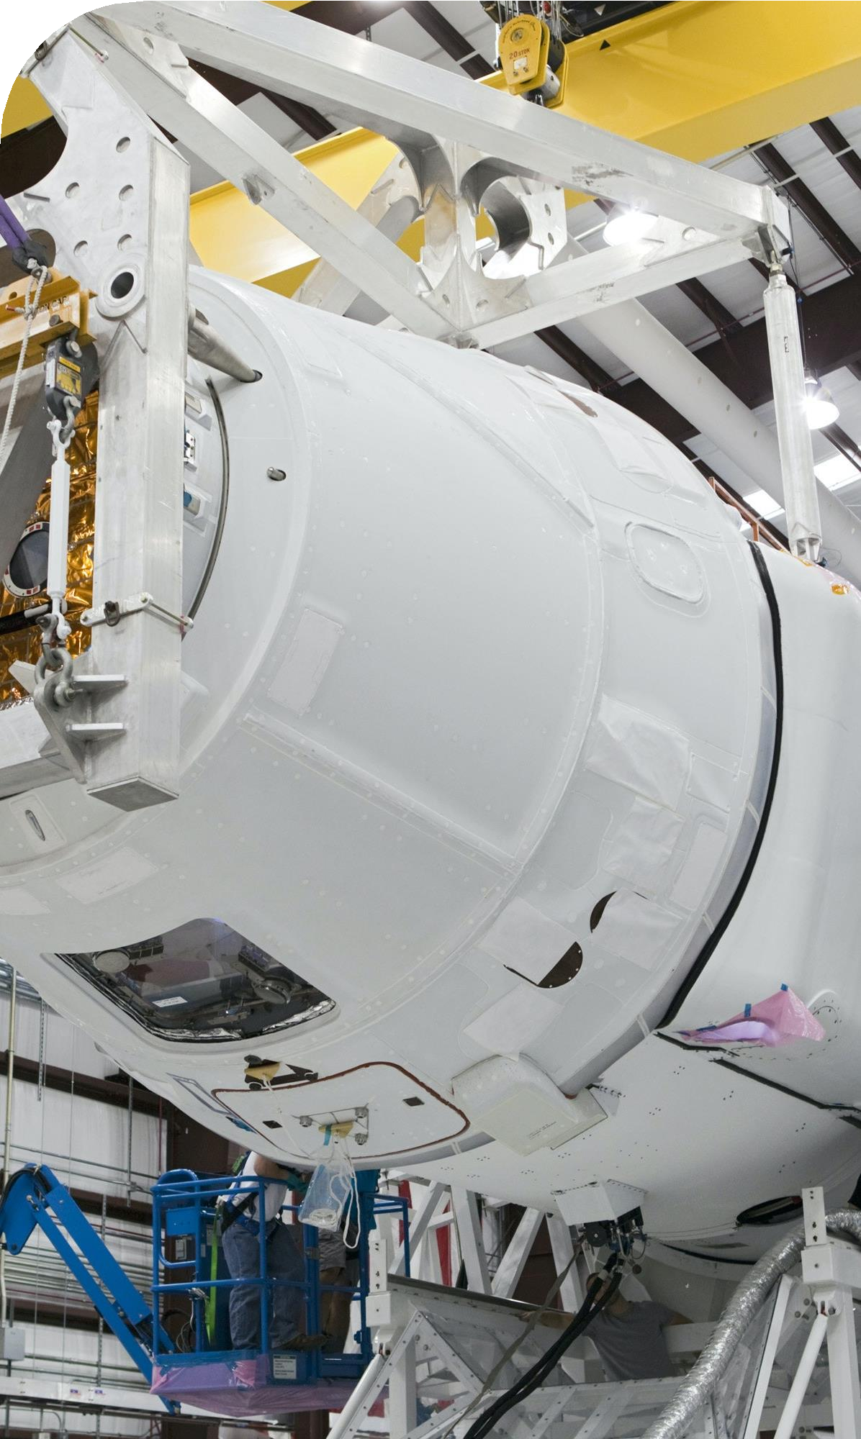
Data Wrangling
Steps Landing Outcome Cont.
Perform EDA and determine data labels
Calculate:
# of launches for each site
# and occurrence of orbit
# and occurrence of mission
outcome per orbit type]
Create binary landing outcome
column (dependent variable)
Export data to csv file
False Ocean: represented an unsuccessful landing to a specific region of ocean
True RTLS: meant the mission had a successful landing on a ground pad
False RTLS: represented an unsuccessful landing on a ground pad
True ASDS: meant the mission outcome had a successful landing on a drone ship
False ASDS: represented an unsuccessful landing on drone ship
Outcomes converted into 1 for a successful landing and 0 for an unsuccessful landing
Landing Outcome
Landing was not always successful
True Ocean: mission outcome had a successful landing to a specific region of the ocean
2023
9

Slide 10
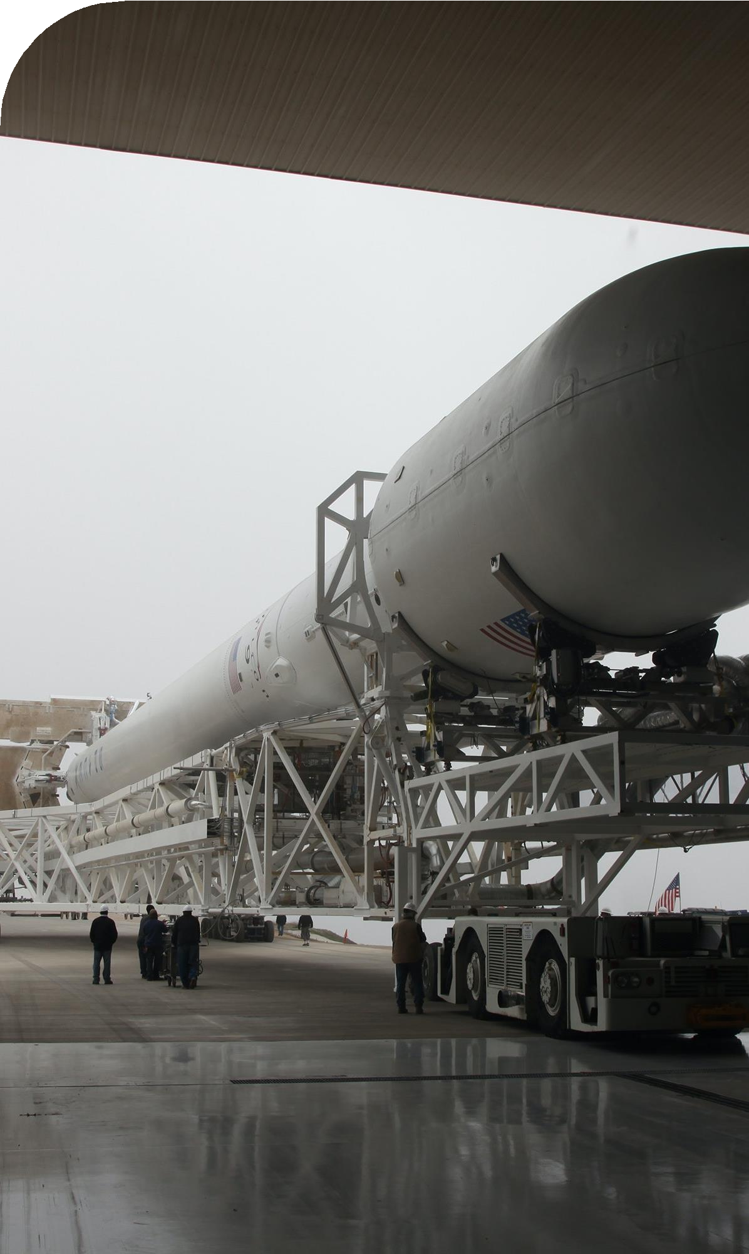
EDA with Visualization
Charts
Flight Number vs. Payload
Flight Number vs. Launch Site
Payload Mass (kg) vs. Launch Site
Payload Mass (kg) vs. Orbit type
Analysis
View relationship by using scatter plots. The variables could be useful for machine learning if a relationship exists
Show comparisons among discrete categories with bar charts. Bar charts
show the relationships among the categories and a measured value.

Slide 11
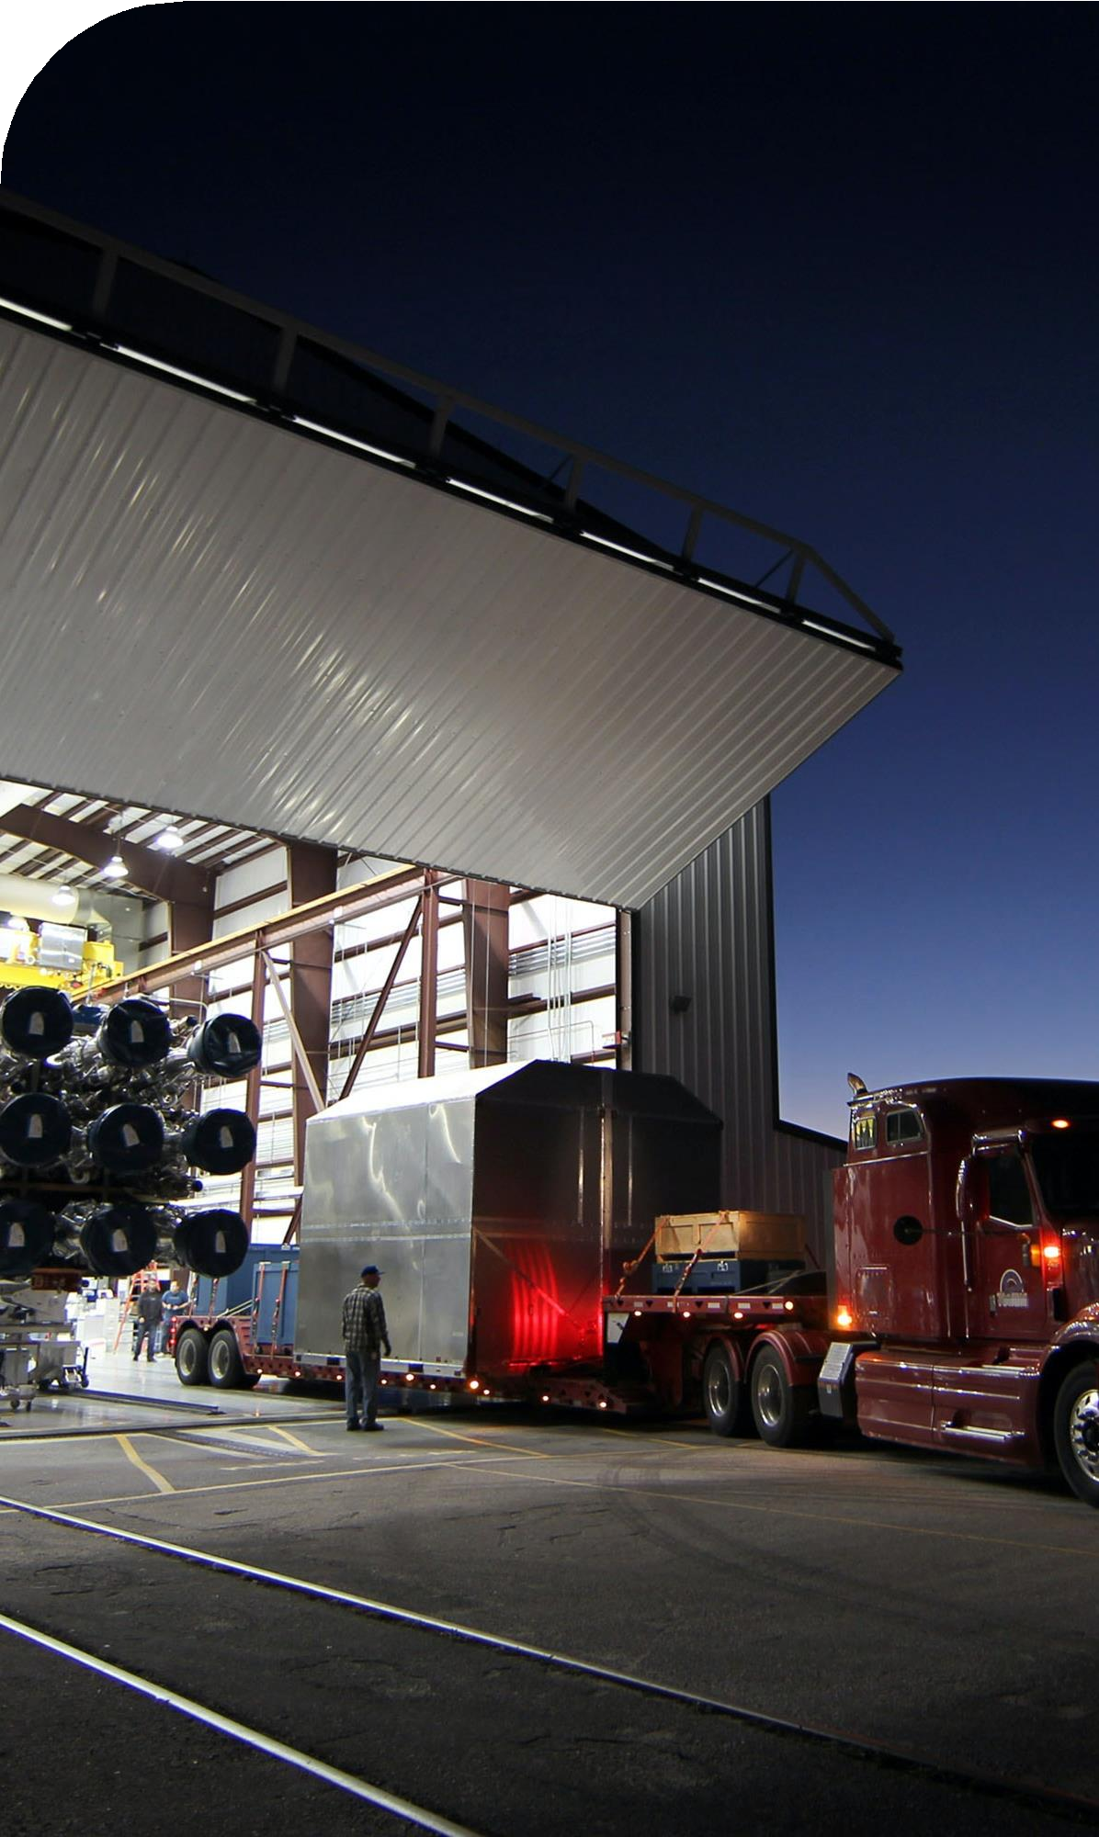
EDA with SQL
Queries
Display:
Names of unique launch sites
5 records where launch site begins with ‘CCA’
Total payload mass carried by boosters launched by NASA (CRS)
Average payload mass carried by booster version F9 v1.1.
List:
Date of first successful landing on ground pad
Names of boosters which had success landing on drone ship and have
payload mass greater than 4,000 but less than 6,000
Total number of successful and failed missions
Names of booster versions which have carried the max payload
Failed landing outcomes on drone ship, their booster version and launch site for the months in the year 2015
Count of landing outcomes between 2010-06-04 and 2017-03-20 (desc)

Slide 12
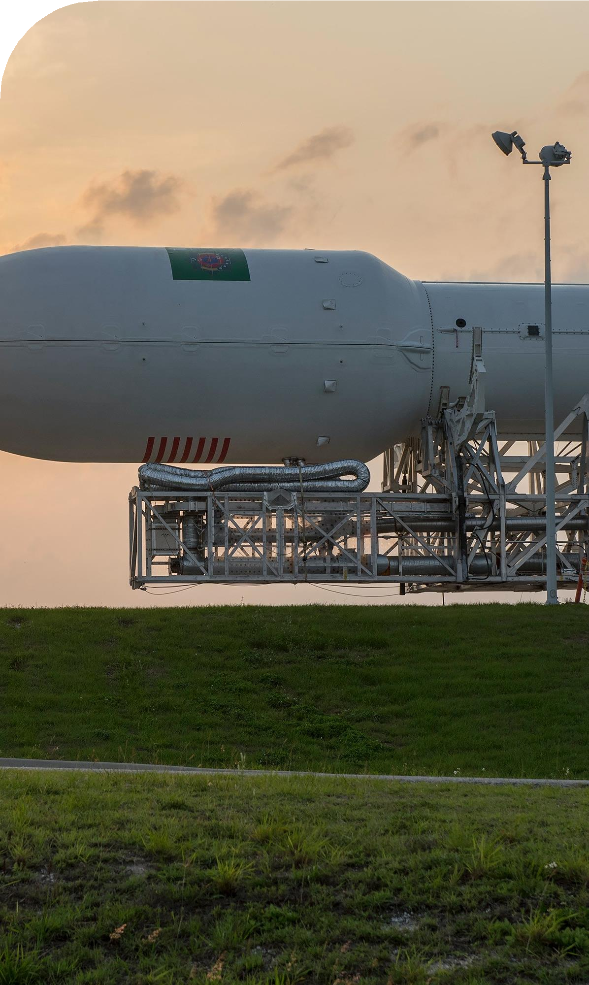
Map with Folium
Markers Indicating Launch Sites
Added blue circle at NASA Johnson Space Center's coordinate with a
popup label showing its name using its latitude and longitude coordinates
Added red circles at all launch sites coordinates with a popup label
showing its name using its name using its latitude and longitude coordinates
Colored Markers of Launch Outcomes
Added colored markers of successful (green) and unsuccessful (red) launches at each launch site to show which launch sites have high success rates
Distances Between a Launch Site to Proximities
Added colored lines to show distance between launch site CCAFS SLC- 40 and its proximity to the nearest coastline, railway, highway, and city

Slide 13
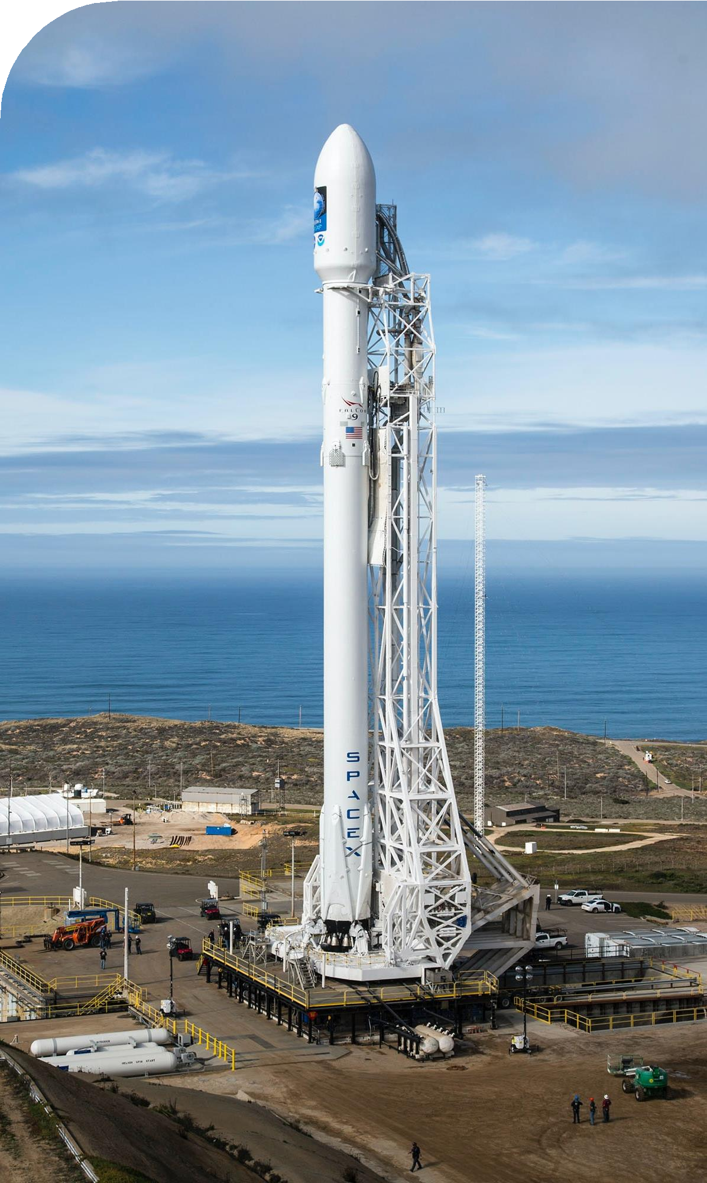
Dashboard with Plotly Dash
Dropdown List with Launch Sites
Allow user to select all launch sites or a certain launch site
Pie Chart Showing Successful Launches
Allow user to see successful and unsuccessful launches as a percent of the total
Slider of Payload Mass Range
Allow user to select payload mass range
Scatter Chart Showing Payload Mass vs. Success Rate by Booster Version
Allow user to see the correlation between Payload and Launch Success

Slide 14
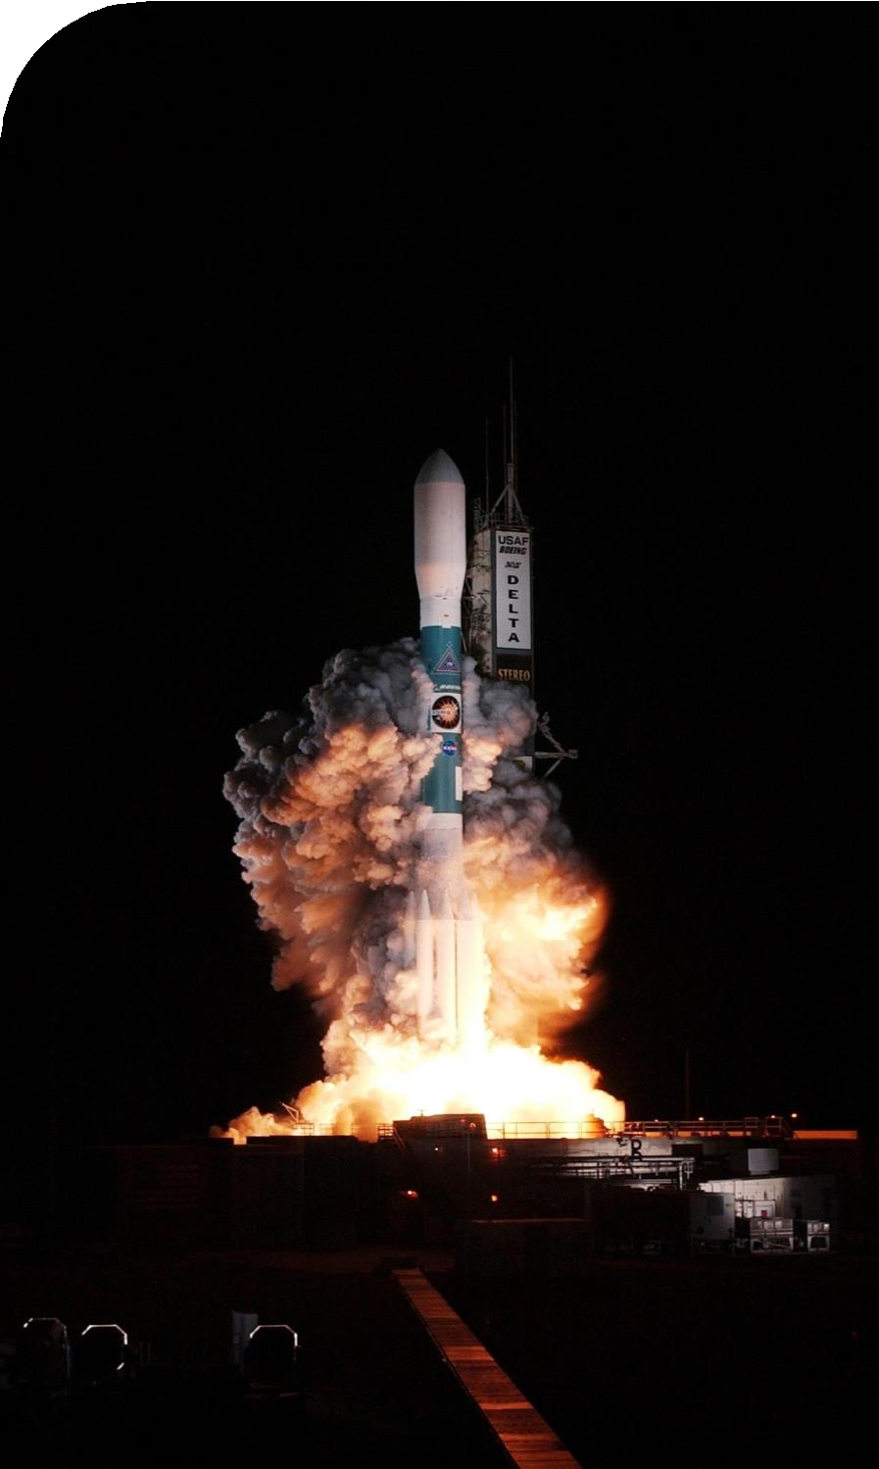
Predictive Analytics
Charts
Create NumPy array from the Class column
Standardize the data with StandardScaler. Fit and transform the data.
Split the data using train_test_split
Create a GridSearchCV object with cv=10 for parameter optimization
Apply GridSearchCV on different algorithms: logistic regression (LogisticRegression()), support vector machine (SVC()), decision tree (DecisionTreeClassifier()), K-Nearest Neighbor (KNeighborsClassifier())
Calculate accuracy on the test data using .score() for all models
Assess the confusion matrix for all models
Identify the best model using Jaccard_Score, F1_Score and Accuracy

Slide 15
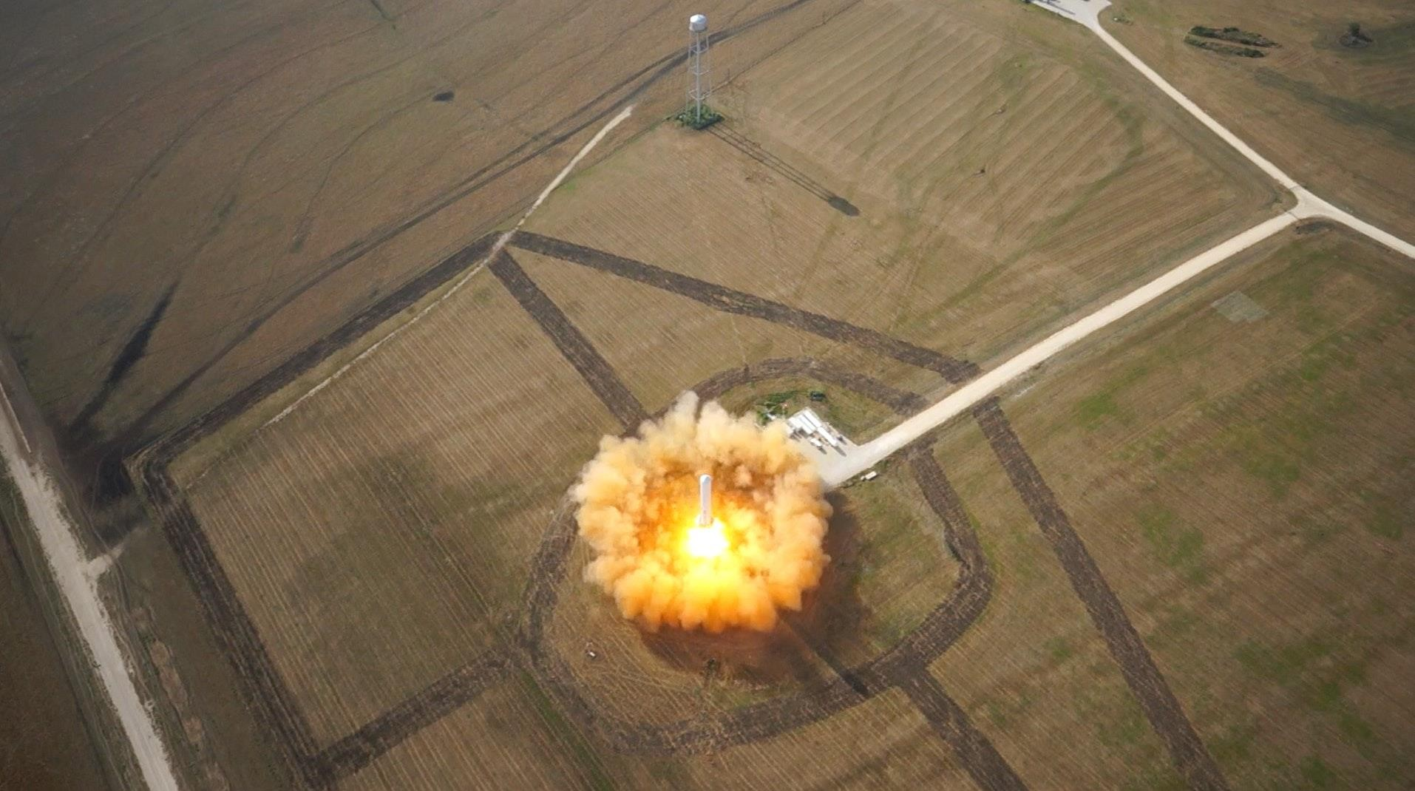
Results

Slide 16
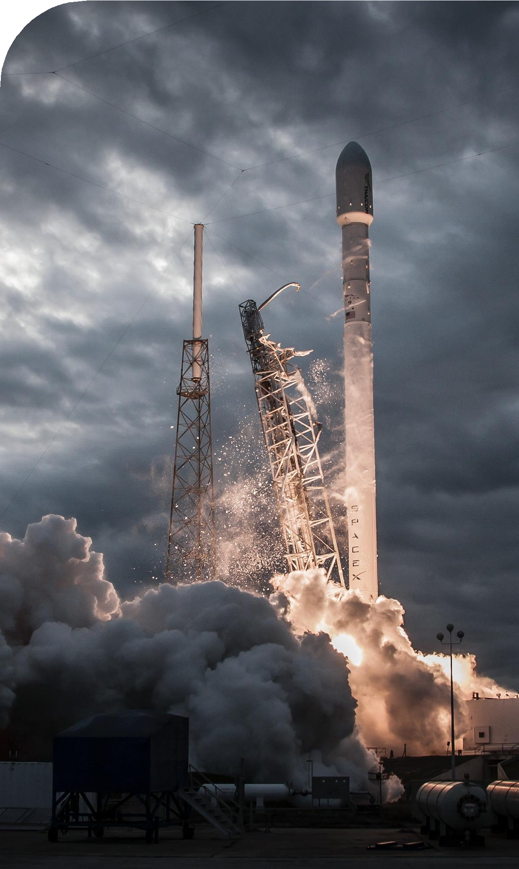
Results Summary
Exploratory Data Analysis
Launch success has improved over time
KSC LC-39A has the highest success rate among landing sites
Orbits ES-L1, GEO, HEO and SSO have a 100% success rate
Visual Analytics
Most launch sites are near the equator, and all are close to the coast
Launch sites are far enough away from anything a failed launch can damage (city, highway, railway), while still close enough to bring people and material to support launch activities
Predictive Analytics
Decision Tree model is the best predictive model for the dataset

Slide 17
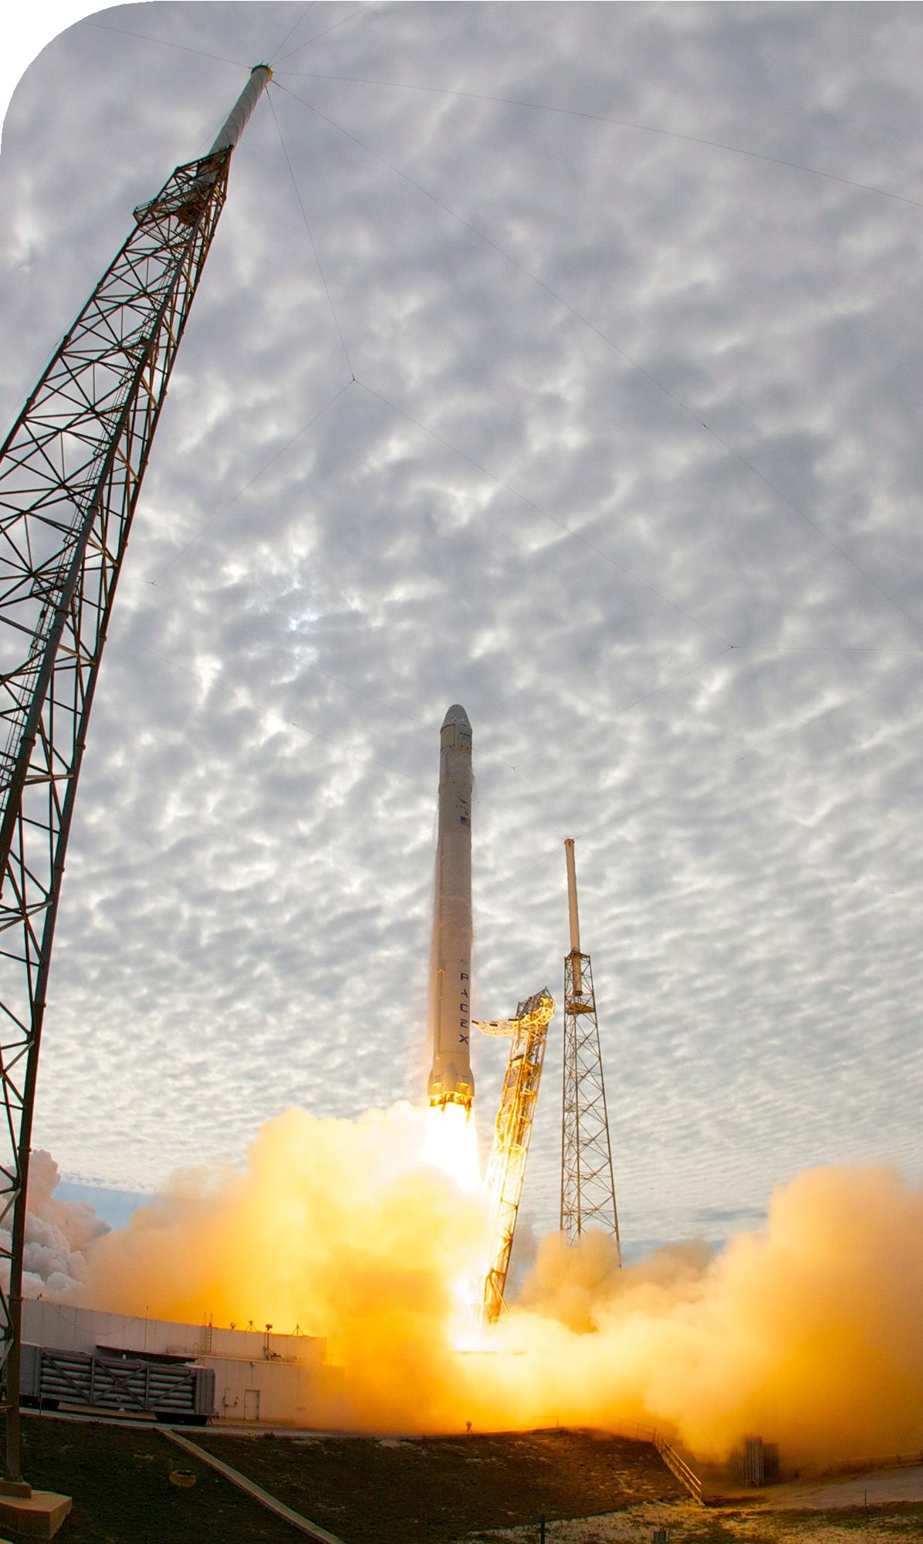
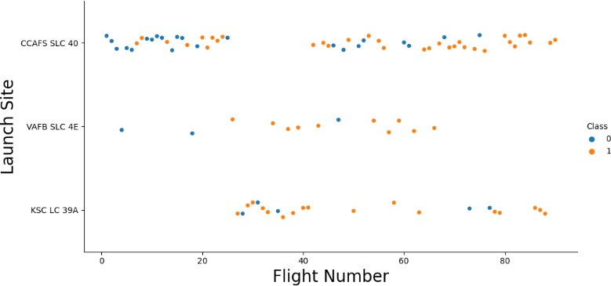
Flight Number vs. Launch Site
Exploratory Data Analysis
Earlier flights had a lower success rate (blue = fail)
Later flights had a higher success rate (orange = success)
Around half of launches were from CCAFS SLC 40 launch site
VAFB SLC 4E and KSC LC 39A have higher success rates
We can infer that new launches have a higher success rate

Slide 18
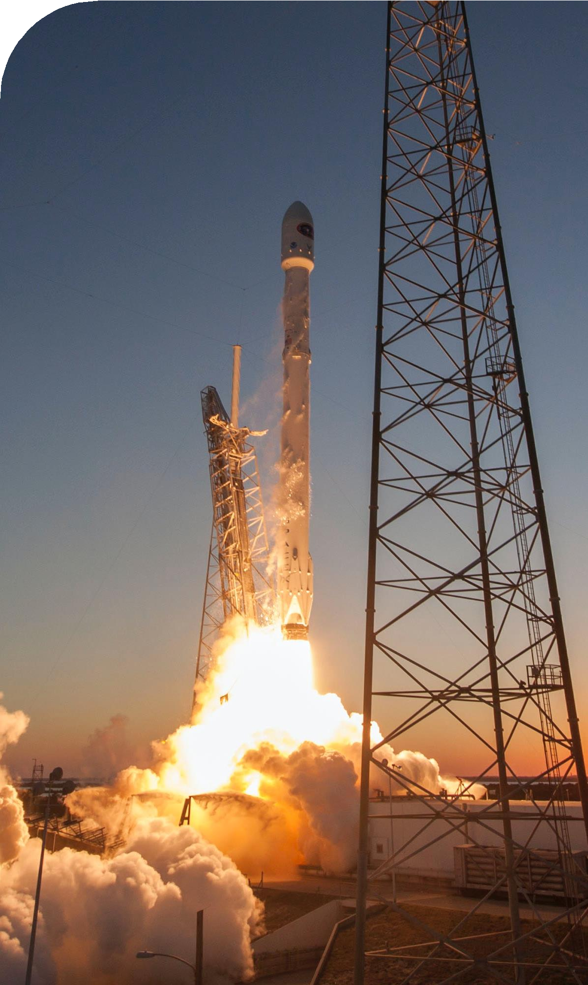
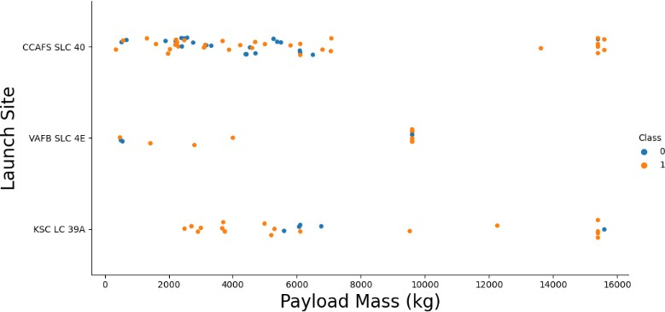
Payload vs. Launch Site
Exploratory Data Analysis
Typically, the higher the payload mass (kg), the higher the success rate
Most launces with a payload greater than 7,000 kg were successful
KSC LC 39A has a 100% success rate for launches less than 5,500 kg
VAFB SKC 4E has not launched anything greater than ~10,000 kg
Class 0 = Fail Class 1 = Success

Slide 19
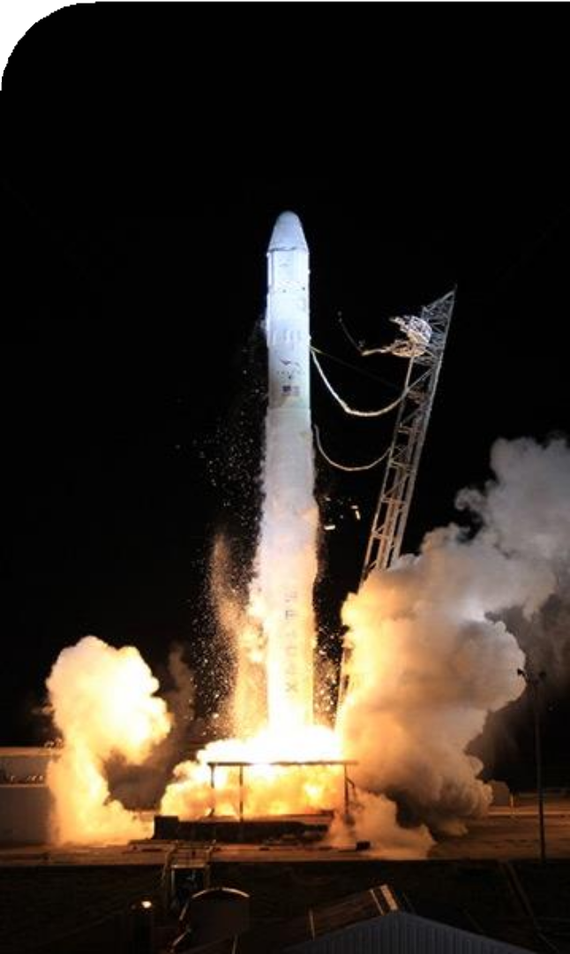
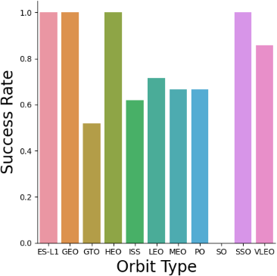
Success Rate by Orbit
Exploratory Data Analysis
100% Success Rate: ES-L1, GEO, HEO and SSO
50%-80% Success Rate: GTO, ISS, LEO, MEO, PO
0% Success Rate: SO

Slide 20
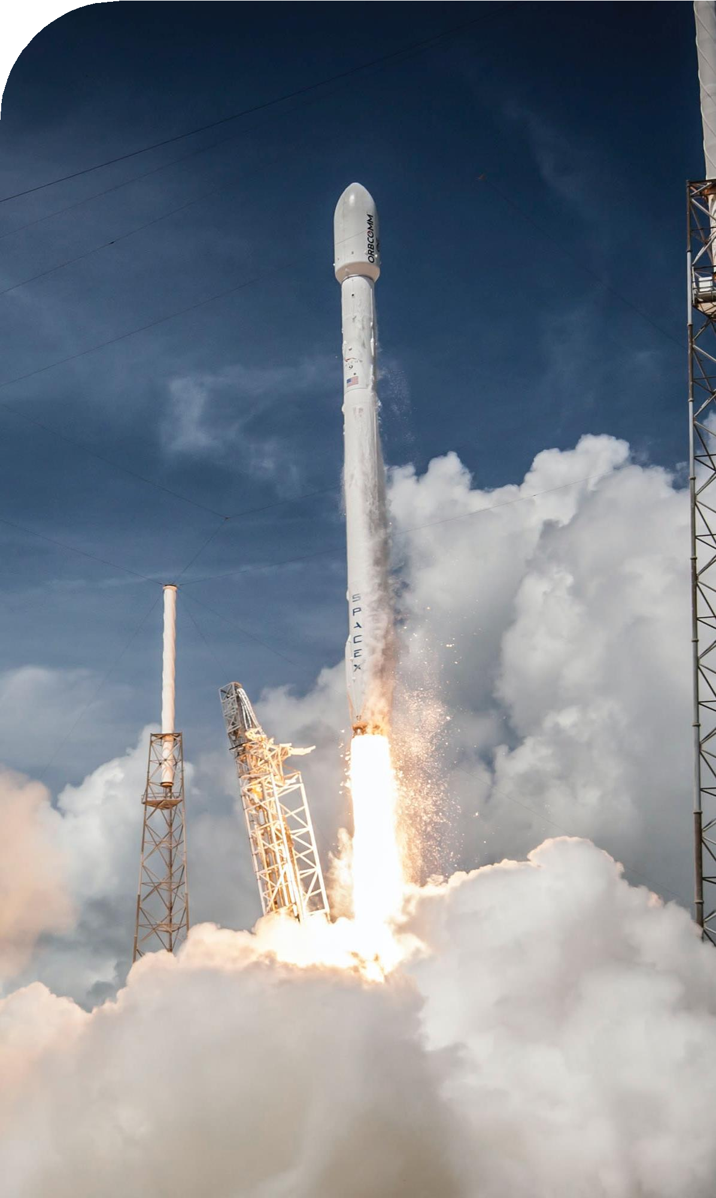
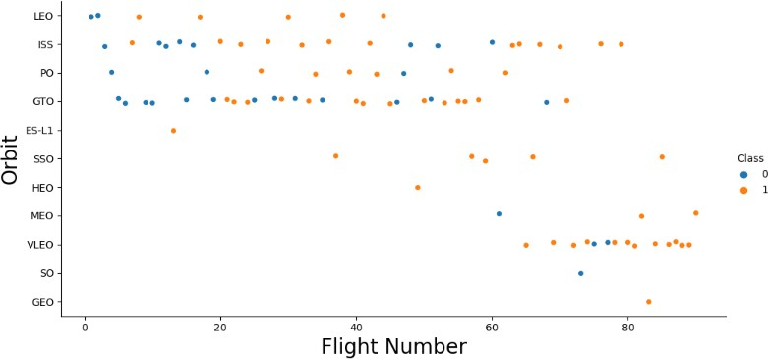
Flight Number vs. Orbit
Exploratory Data Analysis
The success rate typically increases with the number of flights for each orbit
This relationship is highly apparent for the LEO orbit
The GTO orbit, however, does not follow this trend
Class 0 = Fail Class 1 = Success

Slide 21
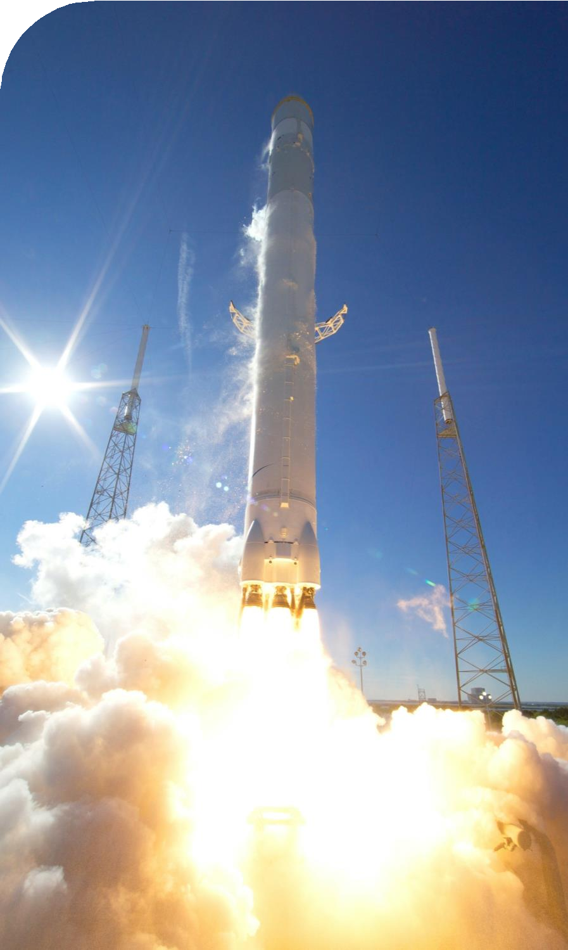
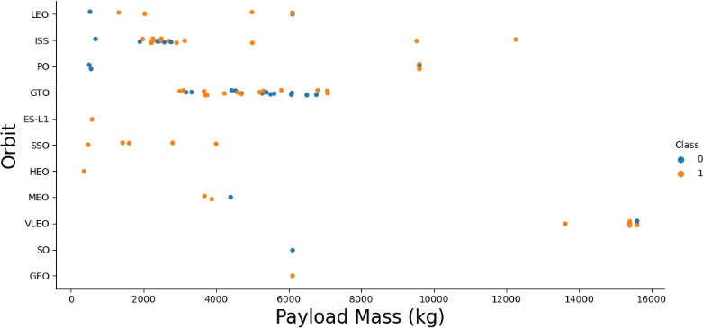
Payload vs. Orbit
Exploratory Data Analysis
Heavy payloads are better with LEO, ISS and PO orbits
The GTO orbit has mixed success with heavier payloads
Class 0 = Fail Class 1 = Success

Slide 22
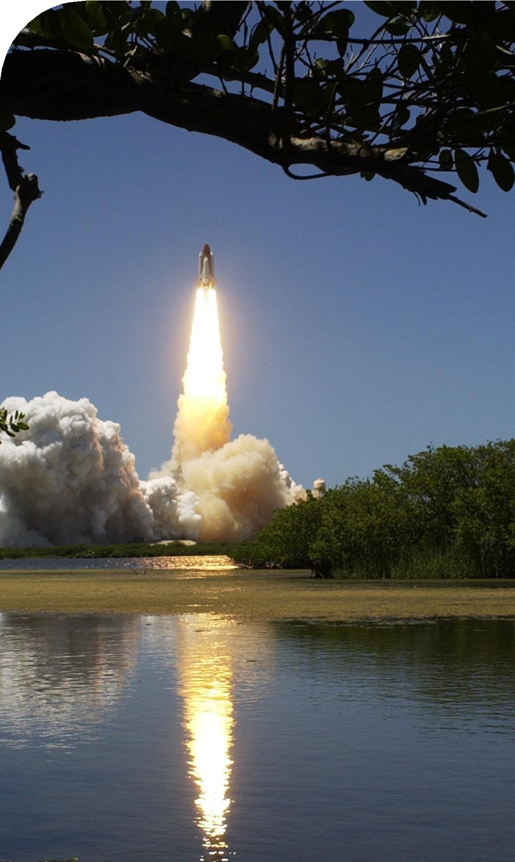
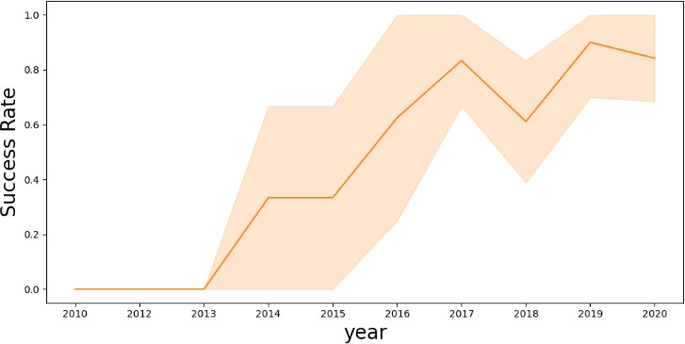
Launch Success over Time
Exploratory Data Analysis
The success rate improved from 2013-2017 and 2018-2019
The success rate decreased from 2017-2018 and from 2019-2020
Overall, the success rate has improved since 2013

Slide 23
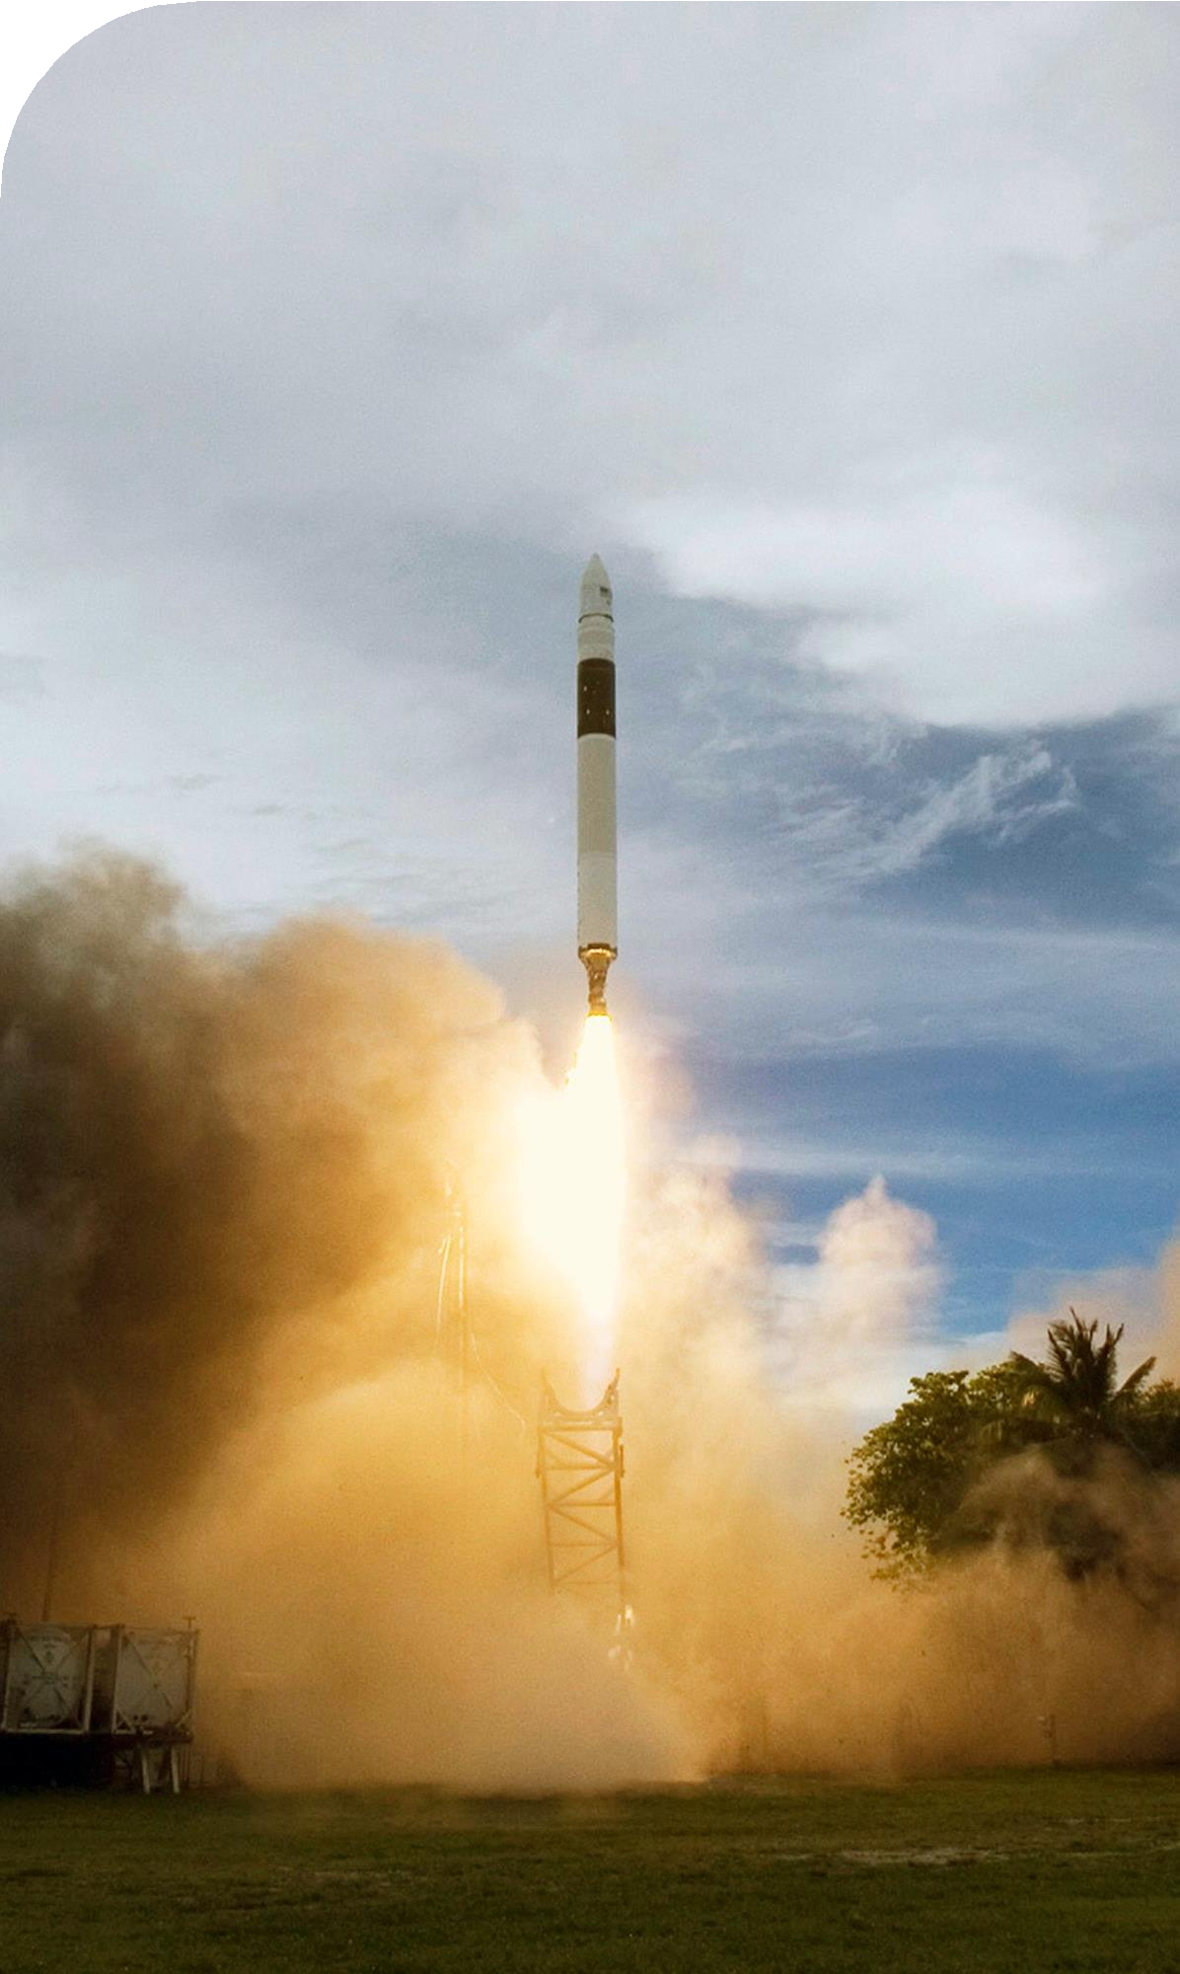
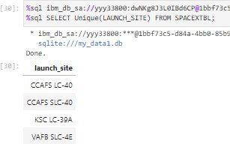
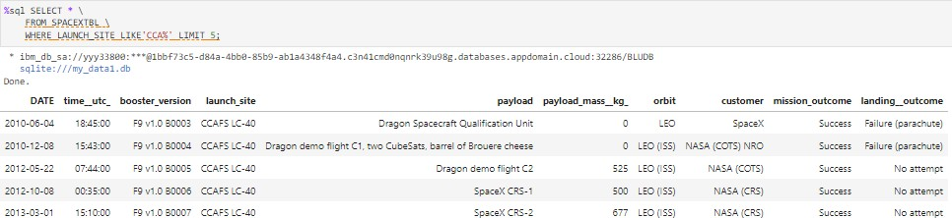
Launch Site Information
Launch Site Names Landing Outcome Cont.
CCAFS LC-40
CCAFS SLC-40
KSC LC-39A
VAFB SLC-4E
Records with Launch Site Starting with CCA
Displaying 5 records below

Slide 24
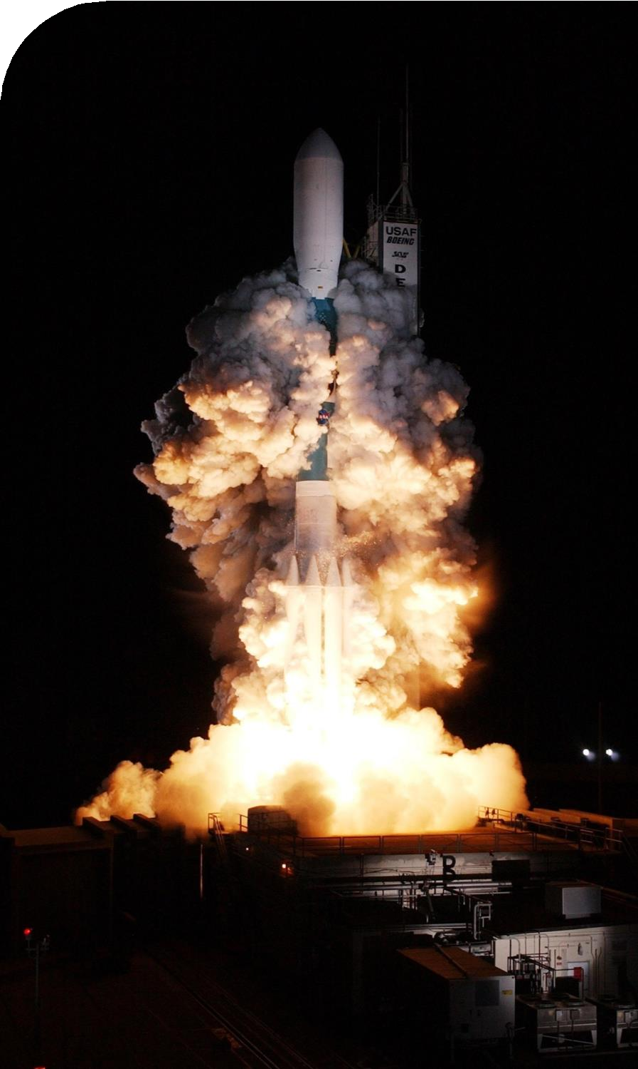
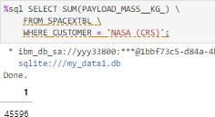
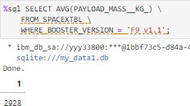
Payload Mass
Total Payload Mass
Average Payload Mass
45,596 kg (total) carried by boosters launched by NASA (CRS)
2,928 kg (average) carried by booster version F9 v1.1

Slide 25
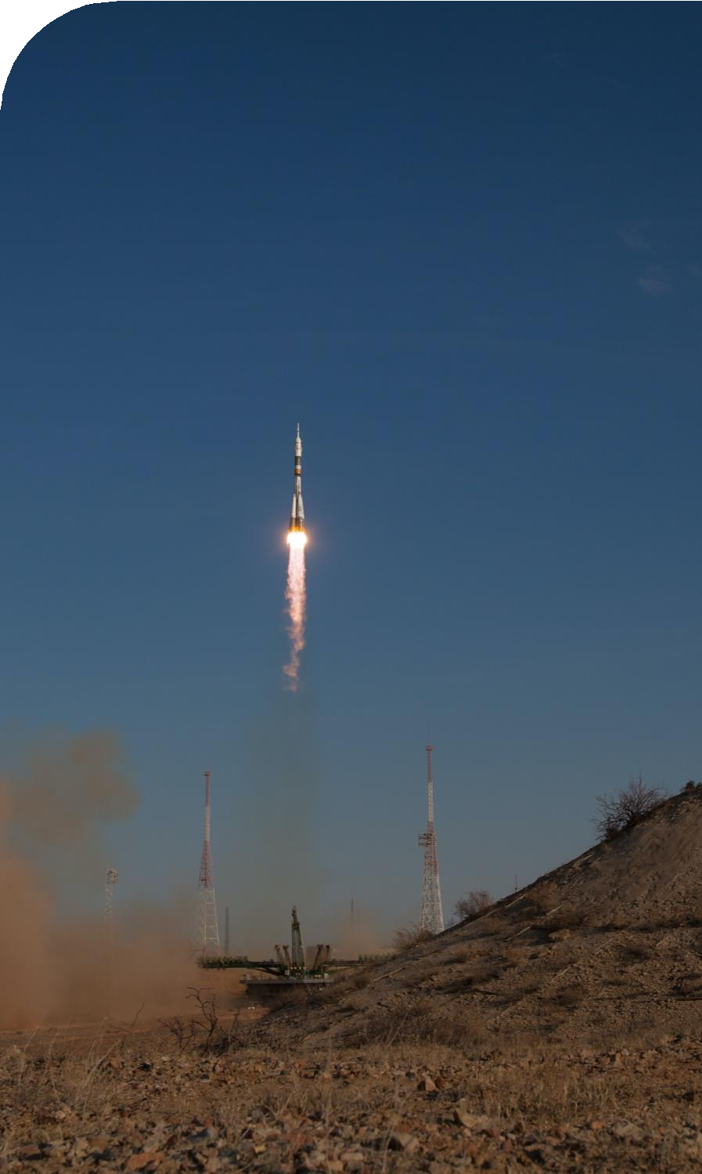
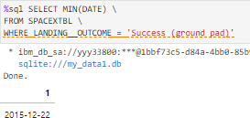
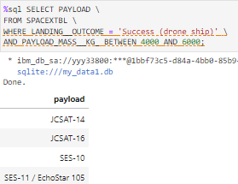
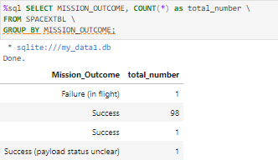
Landing & Mission Info
1st Successful Landing in Ground Pad Booster Drone Ship Landing
12/22/2015
Booster mass greater than 4,000 but less than 6,000
JSCAT-14, JSCAT-16, SES-10,
SES-11 / EchoStar 105
Total Number of Successful and Failed Mission Outcomes
1 Failure in Flight
99 Success
1 Success (payload status unclear)

Slide 26
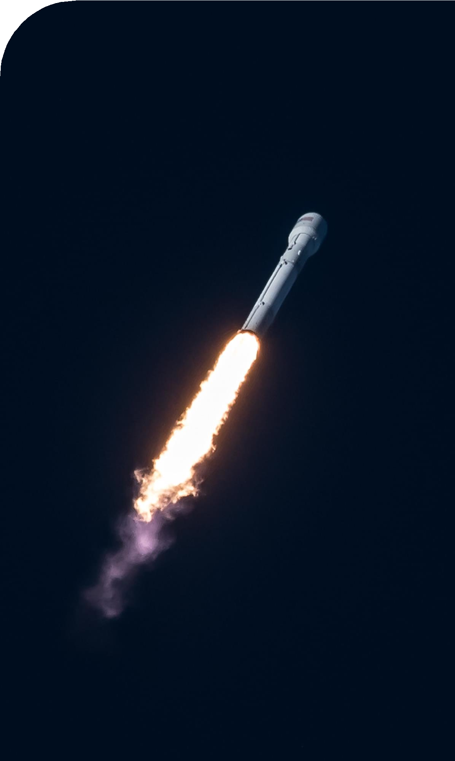
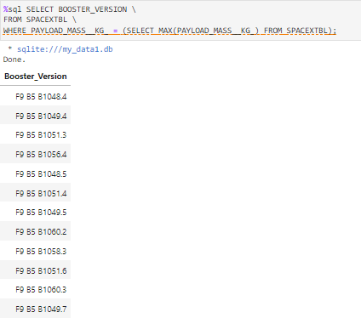
Boosters
Carrying Max Payload
F9 B5 B1048.4
F9 B5 B1049.4
F9 B5 B1051.3
F9 B5 B1056.4
F9 B5 B1048.5
F9 B5 B1051.4
F9 B5 B1049.5
F9 B5 B1060.2
F9 B5 B1058.3
F9 B5 B1051.6
F9 B5 B1060.3
F9 B5 B1049.7

Slide 27
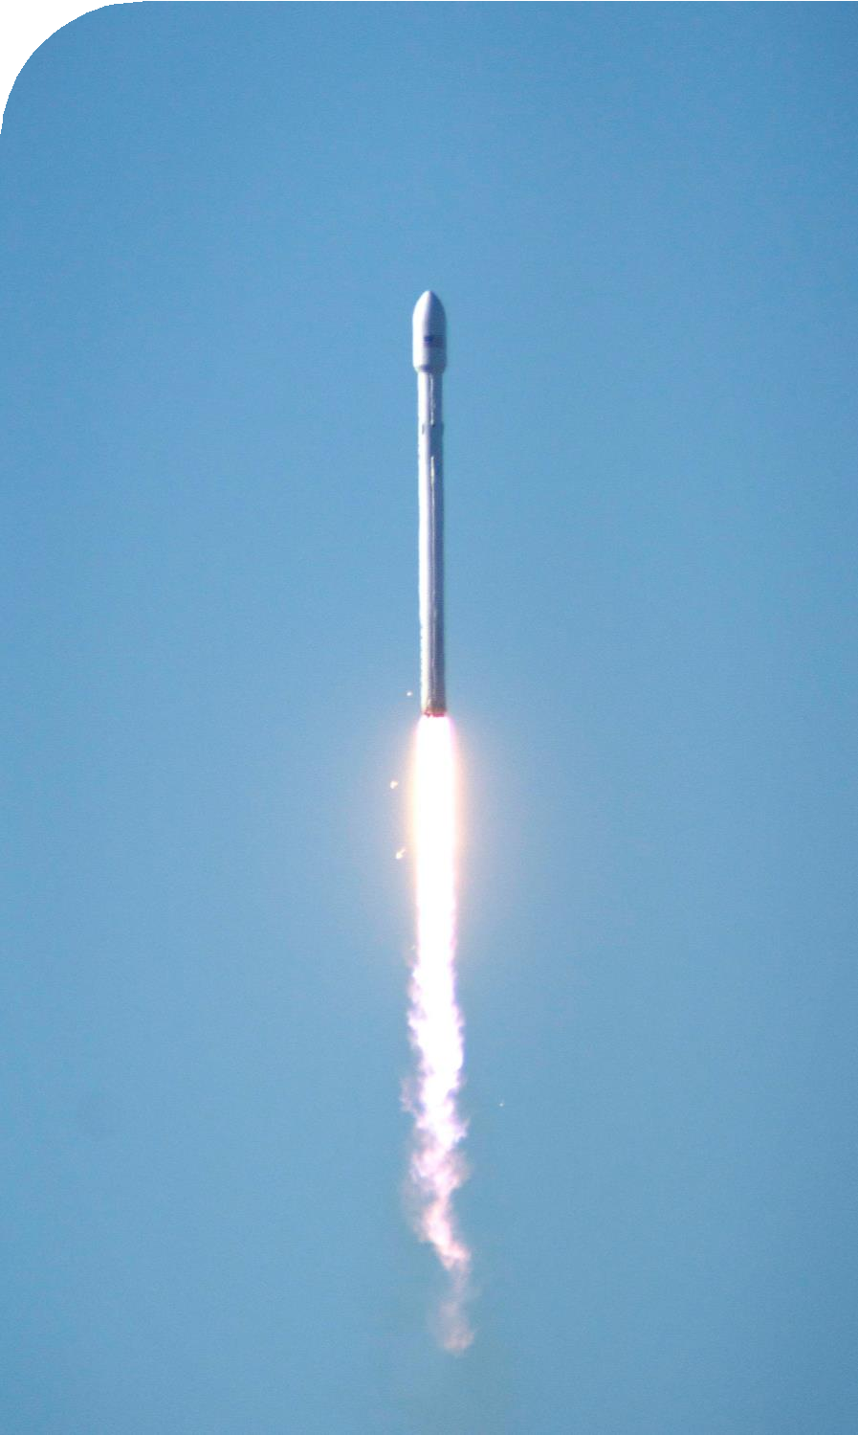
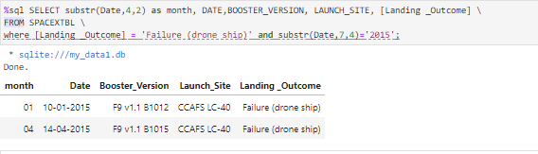
Failed Landings on Drone Ship
In 2015
Showing month, date, booster version, launch site and landing outcome

Slide 28
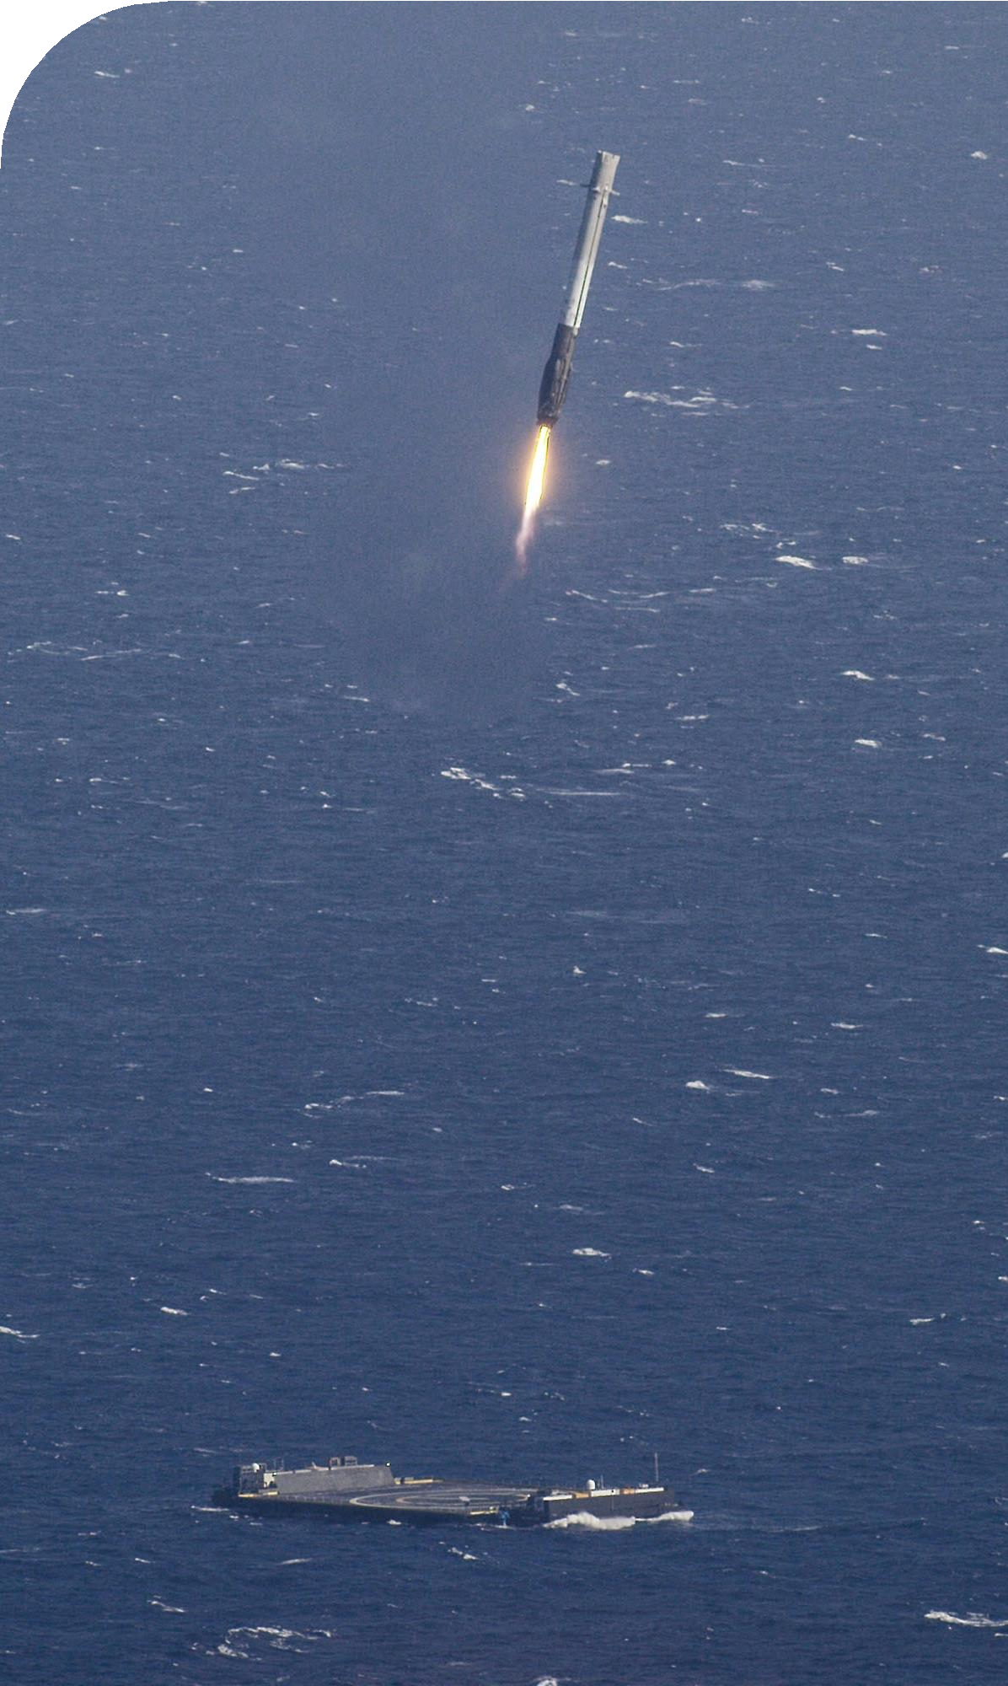
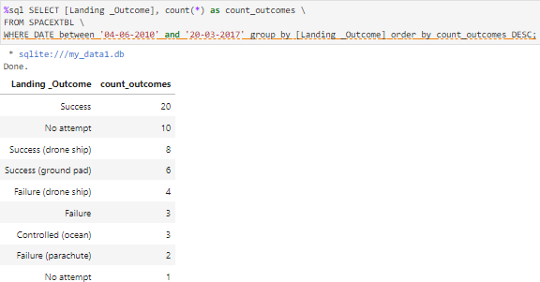
Count of Successful Landings
Ranked Descending
Count of landing outcomes between 2010-06-04 and 2017-03-20 in descending order

Slide 29
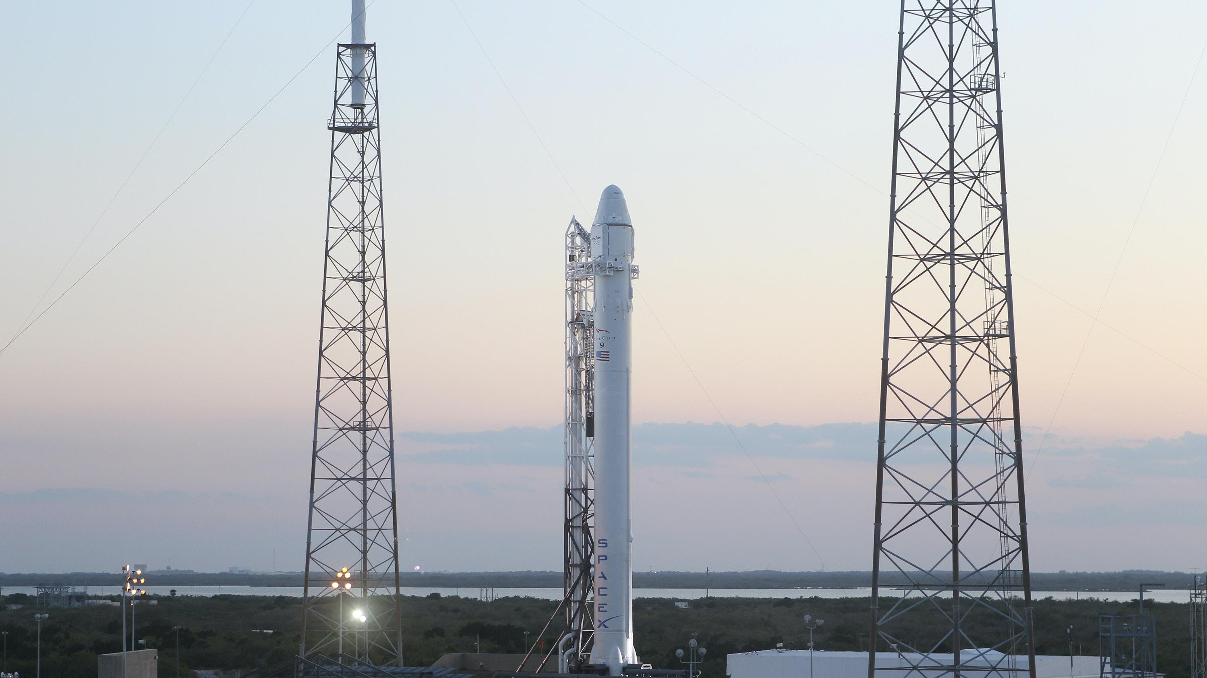
Launch Site Analysis

Slide 30
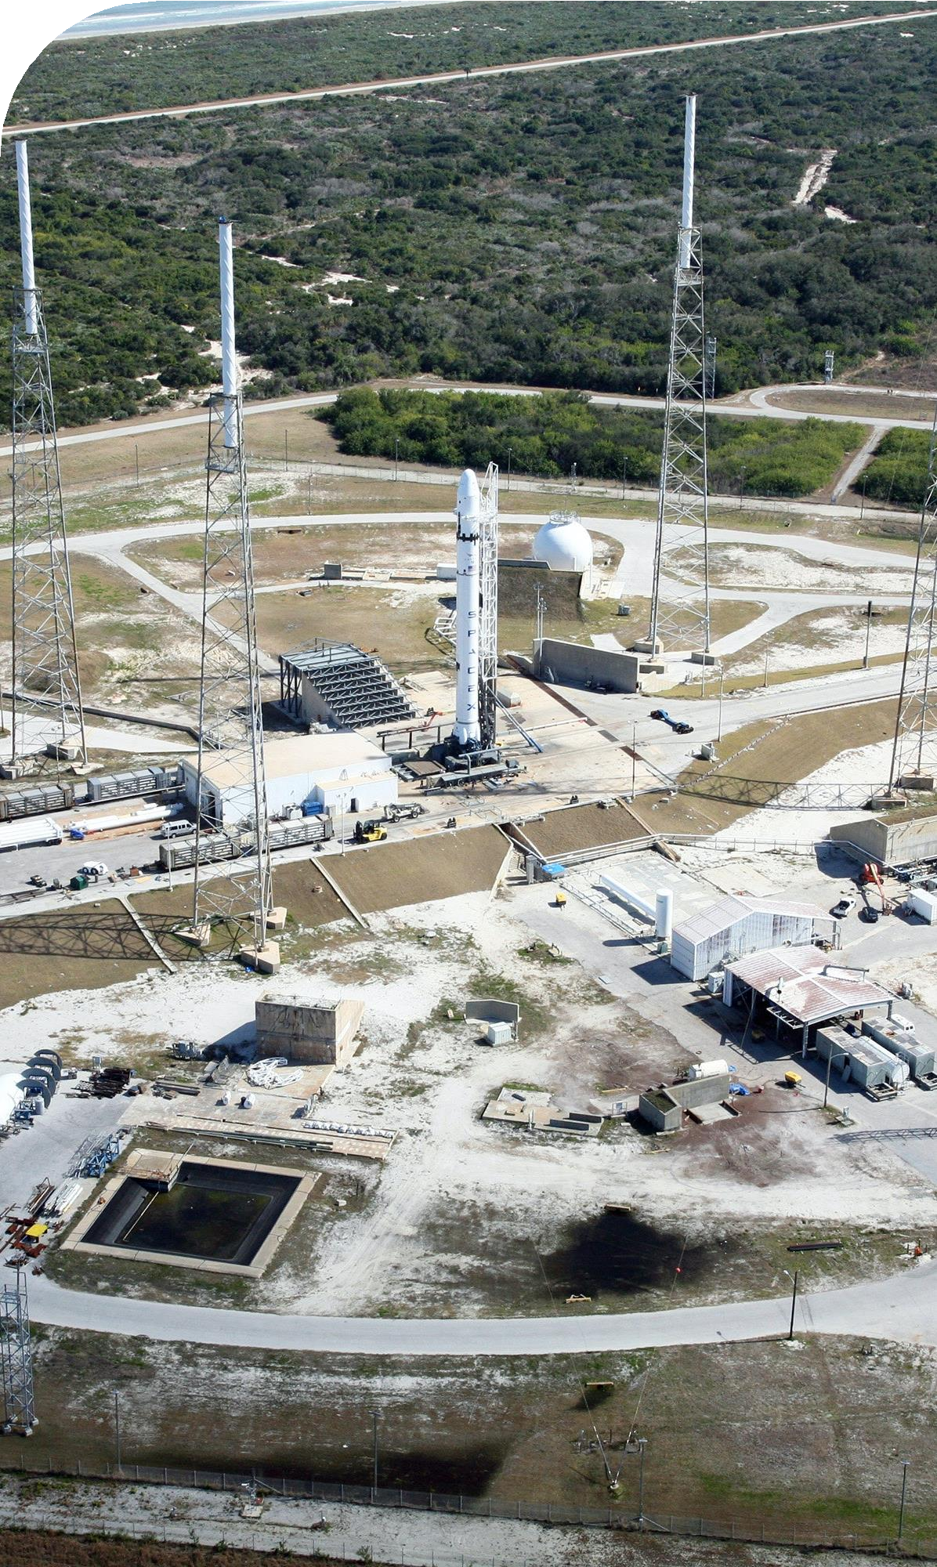
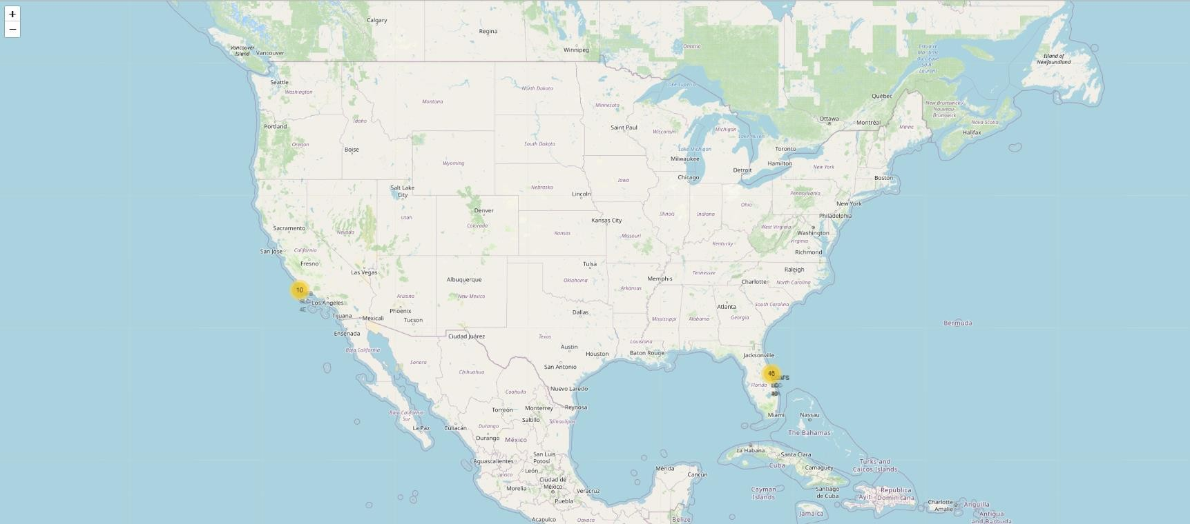
Launch Sites
With Markers
Near Equator: the closer the launch site to the equator, the easier it is to launch to equatorial orbit, and the more help you get from Earth's rotation for a prograde orbit. Rockets launched from sites near the equator get an additional natural boost - due to the rotational speed of earth - that helps save the cost of putting in extra fuel and boosters.

Slide 31
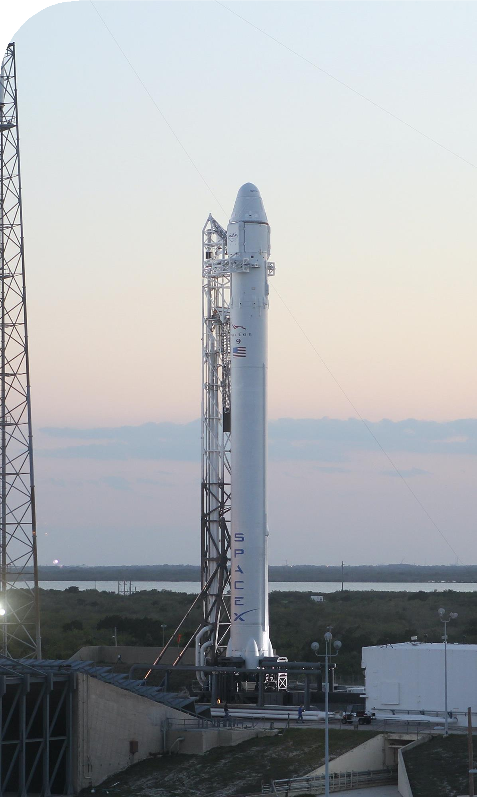
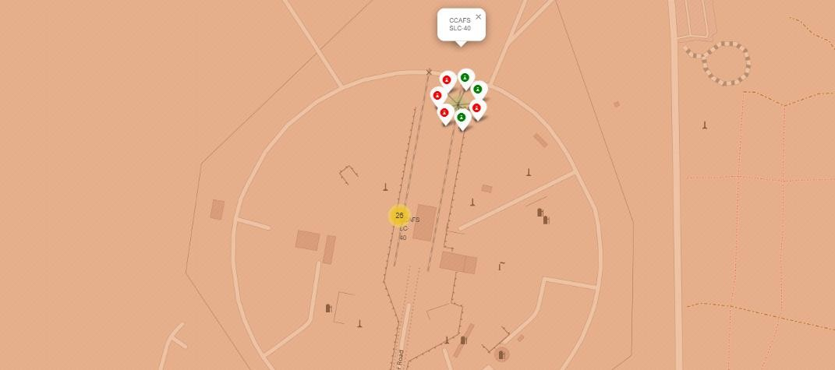
Launch Outcomes
At Each Launch Site
Outcomes:
Green markers for successful launches
Red markers for unsuccessful launches
Launch site CCAFS SLC-40 has a 3/7 success rate (42.9%)

Slide 32
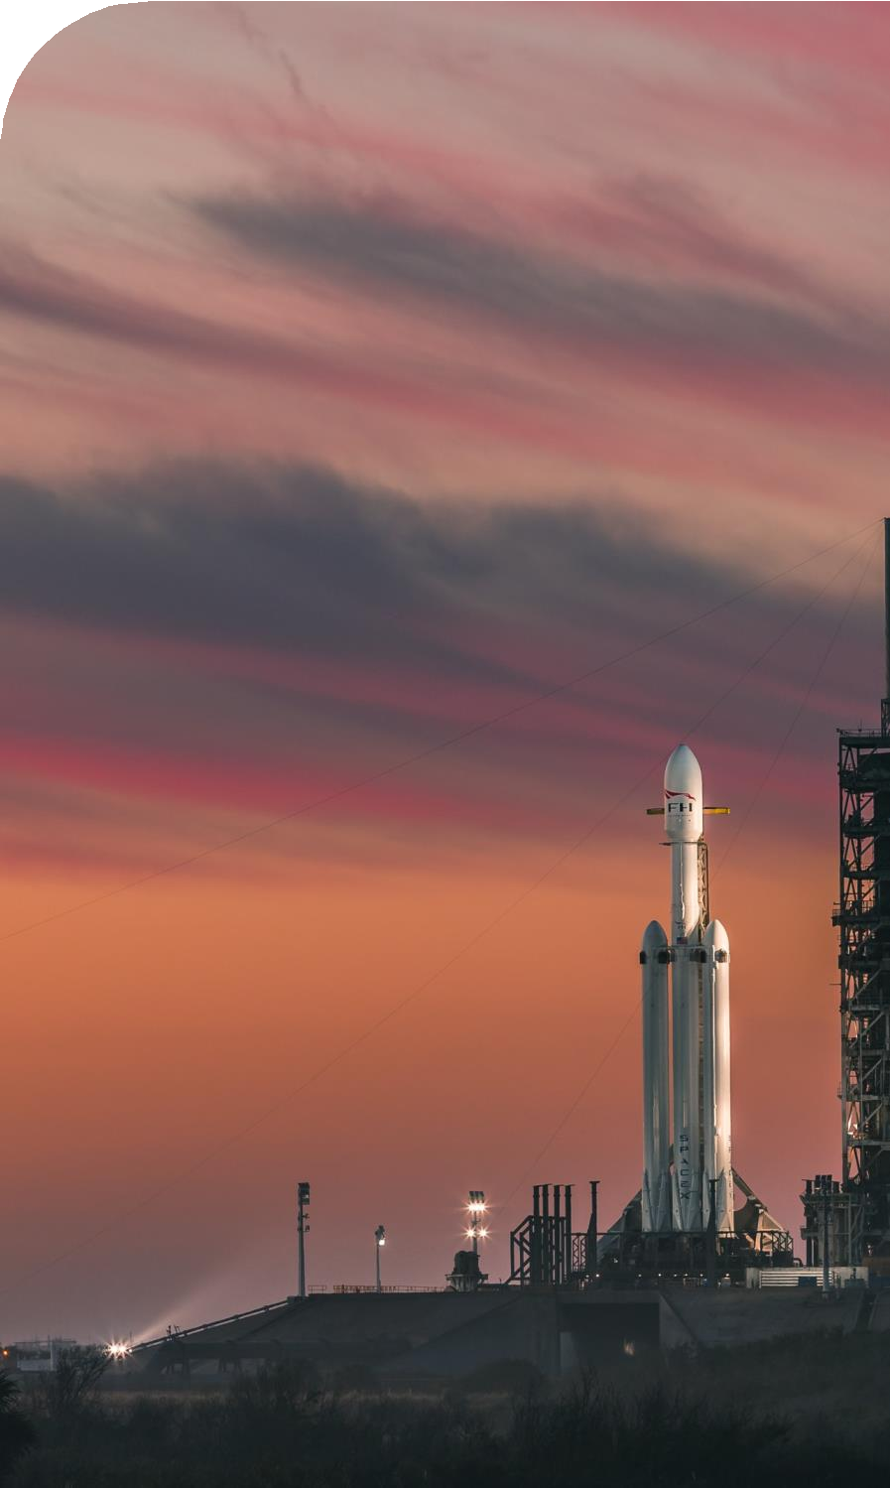

Distance to Proximities
CCAFS SLC-40
.86 km from nearest coastline
21.96 km from nearest railway
23.23 km from nearest city
26.88 km from nearest highway

Slide 33

Distance to Proximities
CCAFS SLC-40
Coasts: help ensure that spent stages dropped along the launch path or failed launches don't fall on people or property.
Safety / Security: needs to be an exclusion zone around the launch site to keep unauthorized people away and keep people safe.
Transportation/Infrastructure and Cities: need to be away from anything a failed launch can damage, but still close enough to roads/rails/docks to be able to bring people and material to or from it in support of launch activities.

Slide 34

Dashboard with Plotly

Slide 35


Launch Success by Site
Success as Percent of Total
KSC LC-39A has the most successful launches amongst launch sites (41.2%)

Slide 36


Launch Success (KSC LC-29A)
Success as Percent of Total
KSC LC-39A has the highest success rate amongst launch sites (76.9%)
10 successful launches and 3 failed launches
Class 0 = Fail Class 1 = Success

Slide 37


Payload Mass and Success
By Booster Version
Payloads between 2,000 kg and 5,000 kg have the highest success rate
1 indicating successful outcome and 0 indicating an unsuccessful outcome

Slide 38

Predictive Analytics

Slide 39



Classification
Accuracy
All the models performed at about the same level and had the same scores and accuracy. This is likely due to the small dataset. The Decision Tree model slightly outperformed the rest when looking at .best_score_
.best_score_ is the average of all cv folds for a single combination of the parameters

Slide 40


Confusion Matrices
Performance Summary
A confusion matrix summarizes the performance of a classification algorithm
All the confusion matrices were identical
The fact that there are false positives (Type 1 error) is not good
Confusion Matrix Outputs:
12 True positive
3 True negative
3 False positive
0 False Negative
Precision = TP / (TP + FP)
12 / 15 = .80
Recall = TP / (TP + FN)
12 / 12 = 1
F1 Score = 2 * (Precision * Recall) / (Precision + Recall)
2 * (.8 * 1) / (.8 + 1) = .89
Accuracy = (TP + TN) / (TP + TN + FP + FN) = .833

Slide 41

Conclusion
Research
Model Performance: The models performed similarly on the test set with the decision tree model slightly outperforming
Equator: Most of the launch sites are near the equator for an additional natural boost - due to the rotational speed of earth - which helps save the cost of putting in extra fuel and boosters
Coast: All the launch sites are close to the coast
Launch Success: Increases over time
KSC LC-39A: Has the highest success rate among launch sites. Has a 100% success rate for launches less than 5,500 kg
Orbits: ES-L1, GEO, HEO, and SSO have a 100% success rate
Payload Mass: Across all launch sites, the higher the payload mass (kg), the higher the success rate

Slide 42

Conclusion
Things to Consider
Dataset: A larger dataset will help build on the predictive analytics results to help understand if the findings can be generalizable to a larger data set
Feature Analysis / PCA: Additional feature analysis or principal component analysis should be conducted to see if it can help improve accuracy
XGBoost: Is a powerful model which was not utilized in this study. It would
be interesting to see if it outperforms the other classification models

Slide 43


